Slide 1
CSCE 5520
Wireless Networks and Protocols
Cellular
1

Slide 2
Overview
Cellular principles – “classic” view
» A bit of history
» Cellular design
» How does a mobile phone call take place?
» Handoff
» Frequency Allocation, Traffic Engineering
Early cellular generations: 1G, 2G, 3G
Today’s cellular: 4G – LTE
Emerging: 5G widely advertised
Some slides based on material from
“Wireless Communication Networks and Systems”
© 2016 Pearson Higher Education, Inc.
2

Slide 3
The Advent of Cellular Networks
“Mobile radio telephone system” was a predecessor of today’s cellular systems
» High power transmitter/receivers
» Could support about 25 channels
» in a radius of 80 Km
Over time, to increase network capacity:
» Multiple lower power transmitters (100W or less)
» Smaller transmission radius -> area split in cells
» Each cell with its own frequencies and base station
» Adjacent cells use different frequencies
» The same frequency can be reused at sufficient distance
These trends are continuing …
3

Slide 4
The Cellular Idea
In December 1947 Donald H. Ring outlined the idea in a Bell labs memo
Split an area into cells, each with their own low power towers
Each cell would use its own frequency
Did not take off due to “extreme-at-the-time” processing needs
» Handoff for thousands of users
» Rapid switching infeasible – maintain call while changing frequency
» Technology not ready
4

Slide 5
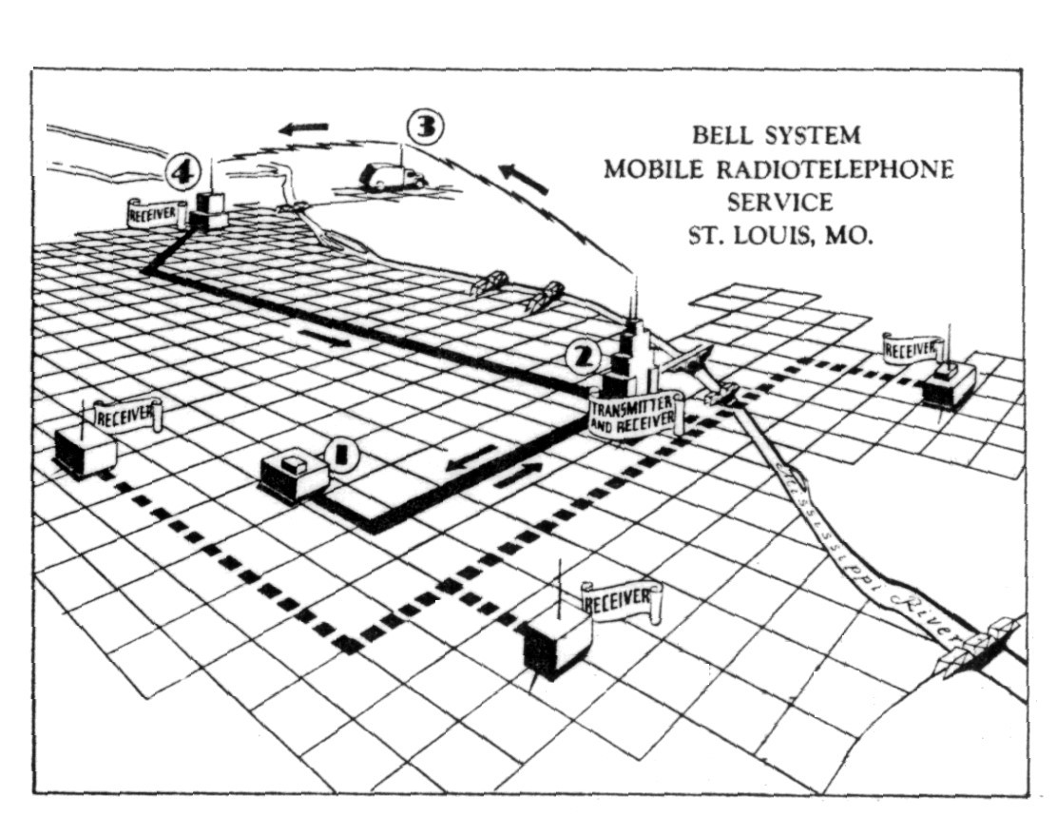
The MTS network
http://www.privateline.com/PCS/images/SaintLouis2.gif
5

Slide 6
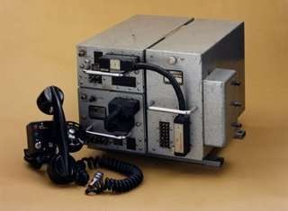
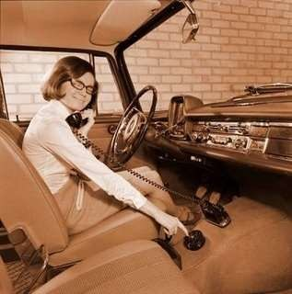
The Early Mobile Phones
First mobile phones bulky, expensive and hardly portable, let alone mobile
» Phones weighed ~40 Kg
» Some early prototypes were much bulkier than shown in the pictures (think: large backpack)
Operator assisted with maximum 250 users
6

Slide 7
… the Remaining Components
In December 1947 the transistor was invented by William Shockley, John Bardeen, and Walter Brattain
Why no portable phones at that time?
A mobile phone needs to send a signal – not just receive and amplify
The energy required for a mobile phone transmission still too high for the high power/high tower approach – could only be done with a car battery
7

Slide 8
… and the Regulatory Bodies
The FCC commissioner Robert E. Lee said that mobile phones were a status symbol and worried that every family might someday believe that its car had to have one.
Lee called this a case of people “frivolously using spectrum” simply because they could
afford to.
From The Cell-Phone Revolution, AmericanHeritage.com
8

Slide 9
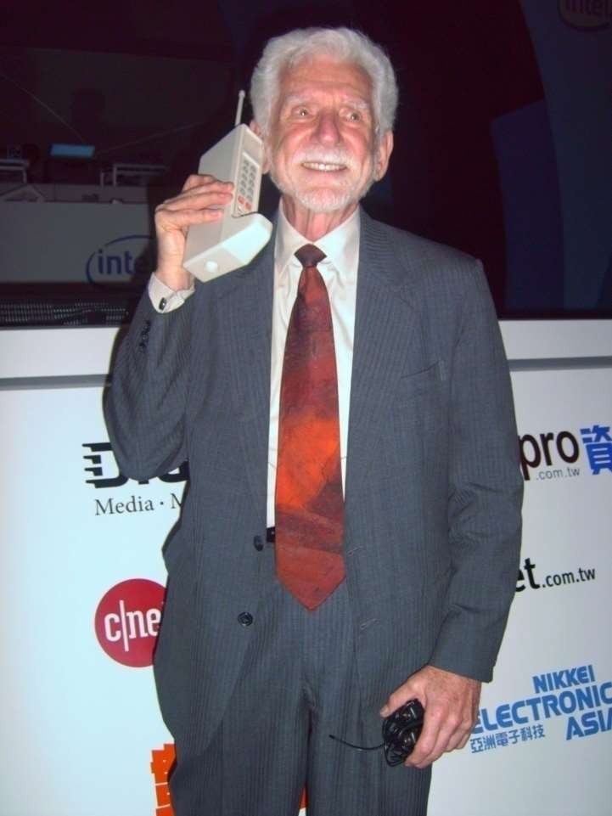
DynaTAC8000X:
the First Cell Phone
The “brick”:
» Weighed 2 pounds
» Offered 30 mins of talk time
» Sold for $3,995!
It took 10 years to develop (1973-1983) at a cost of
$100 million!
» Size determined by size of batteries, antennas, keypad, etc.
» Today size determined by the UI!
First commercial service in early 80s
» FCC allocated spectrum in 70s
Dr. Martin Cooper of Motorola, made the first US analogue mobile phone call on a larger prototype model in 1973
10

Slide 10
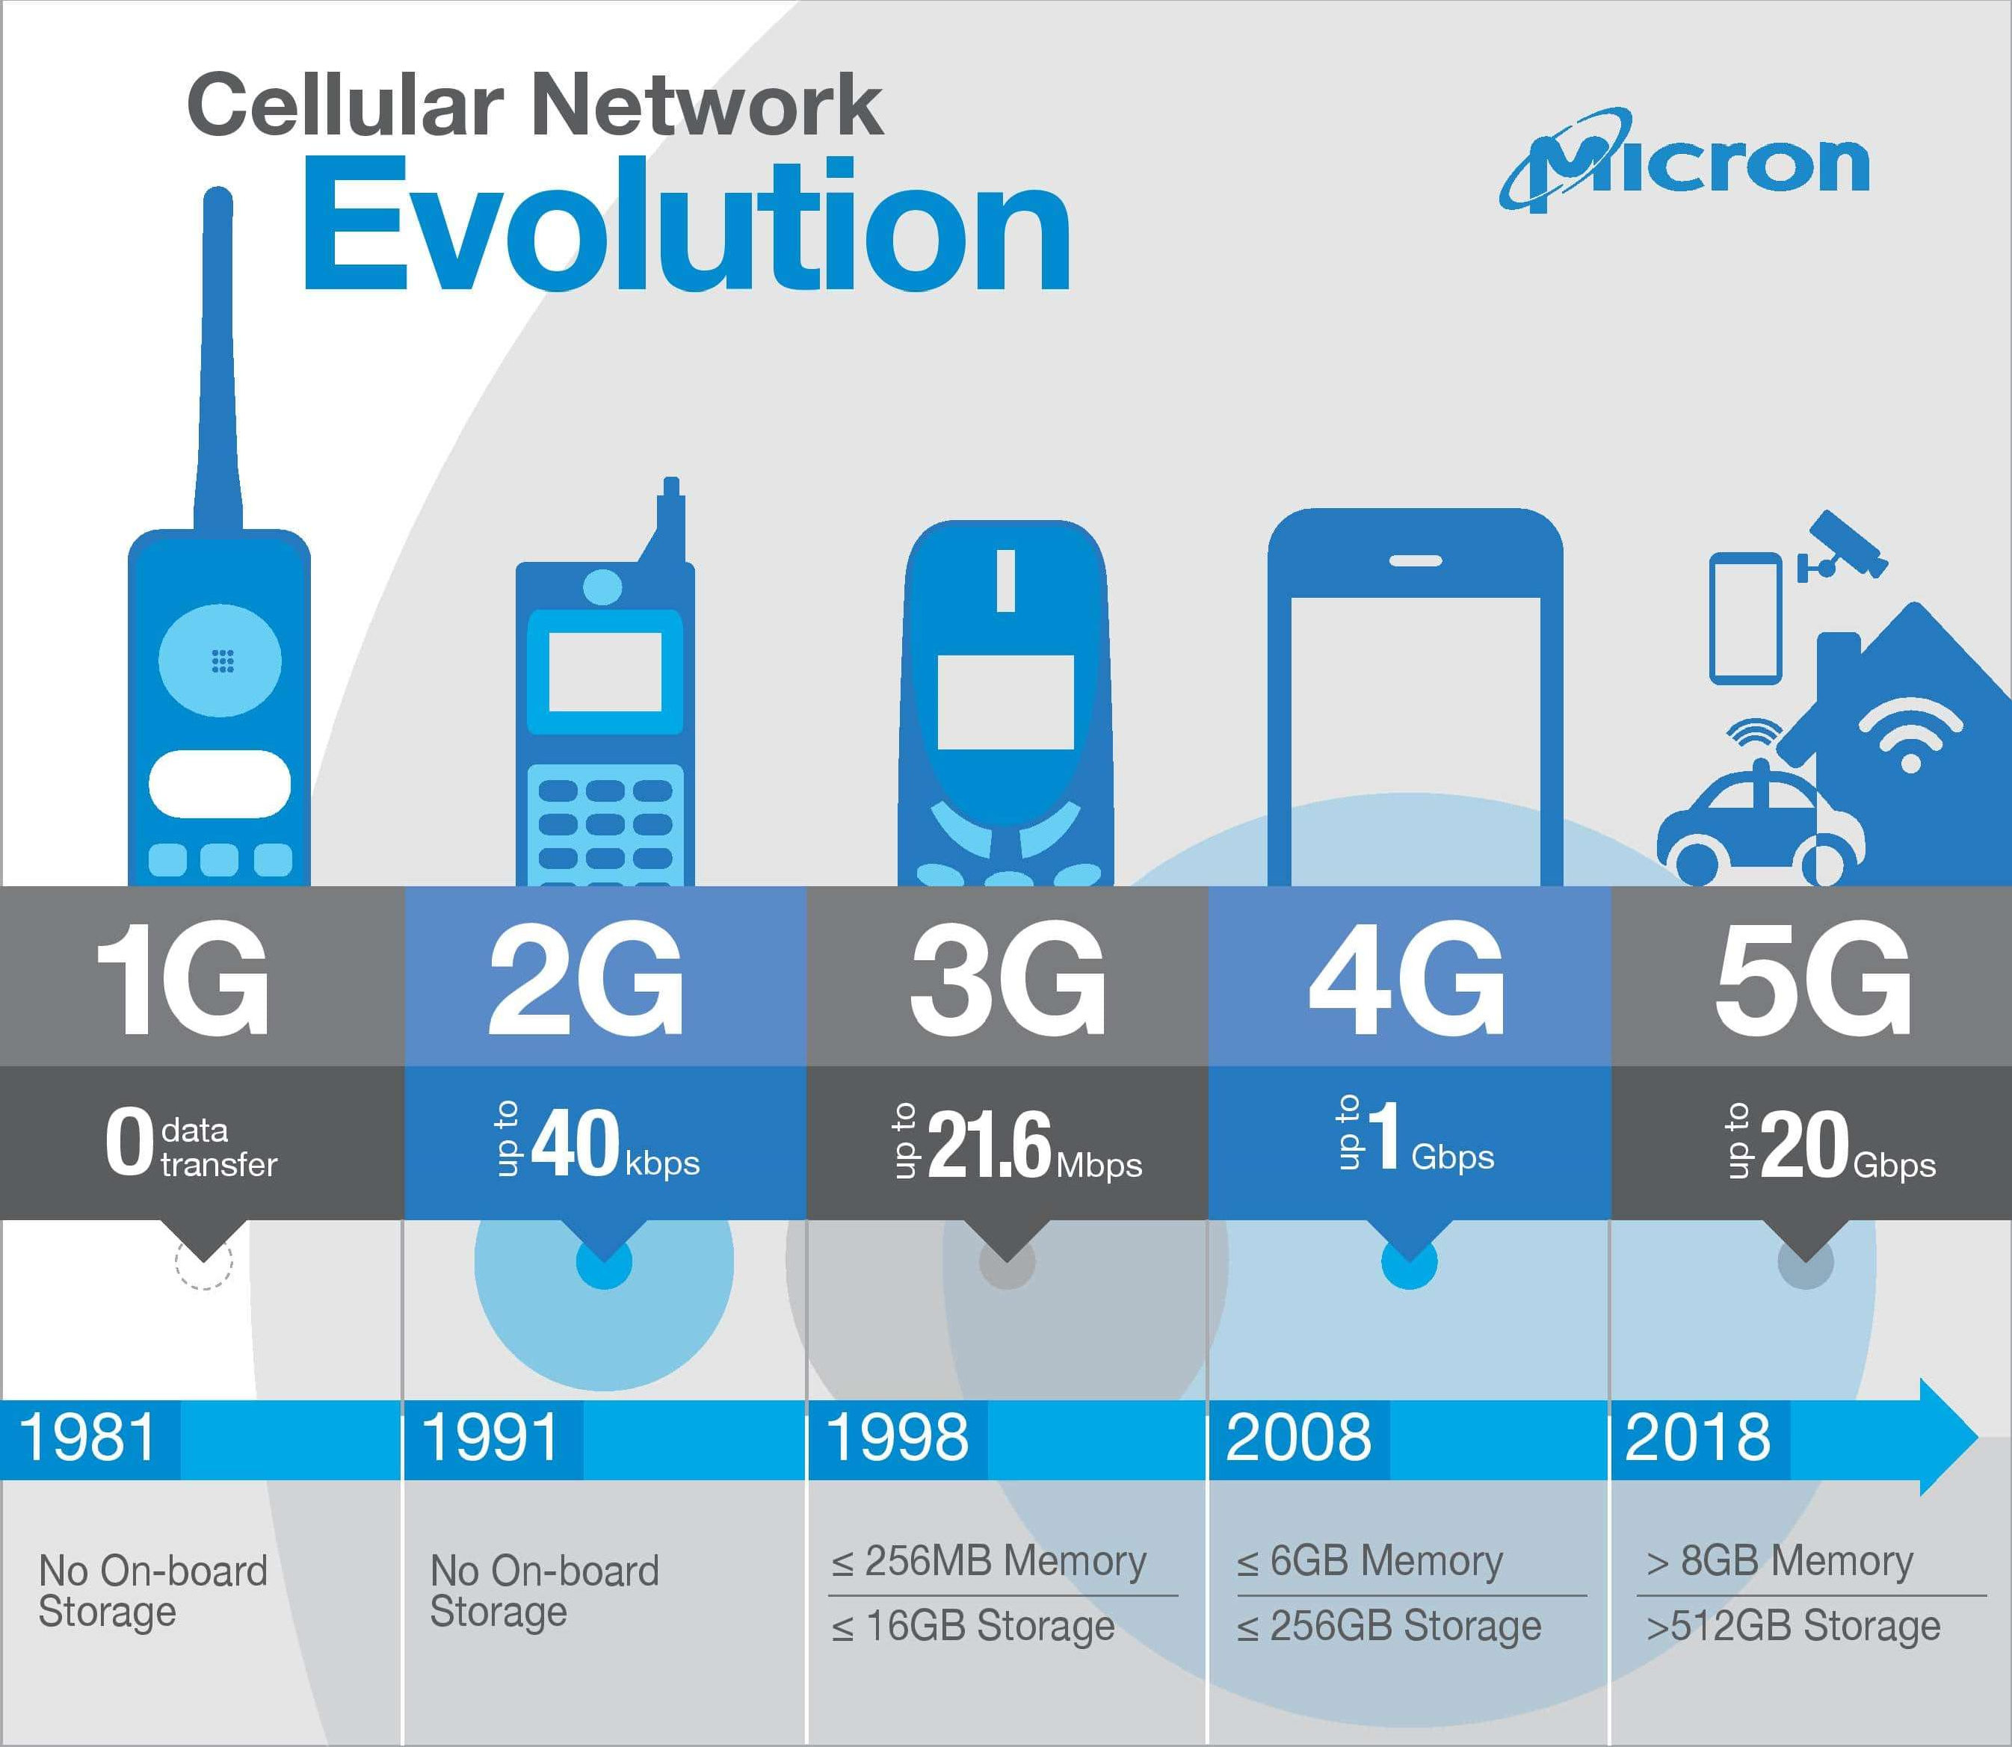
Cellular Generations
Roughly one generation every 10 years
Spectrum allocation for mobile broadband has increased significantly
» Shift to higher frequencies
eetimes.com
11
Peter A. Steenkiste

Slide 11
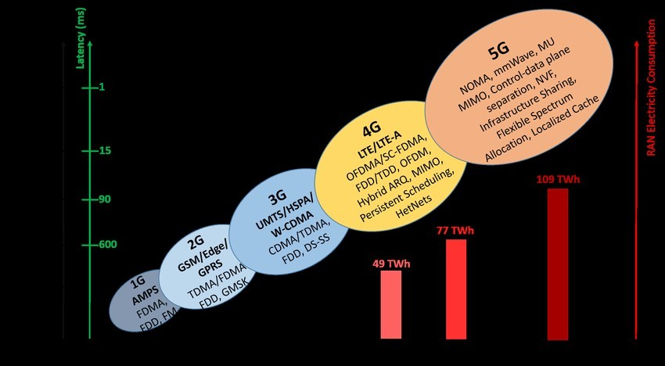
Technologies Used
We have already seen many of these technologies!
Terminology for 5G is a bit different – How?
Peter A. Steenkiste
12

Slide 12
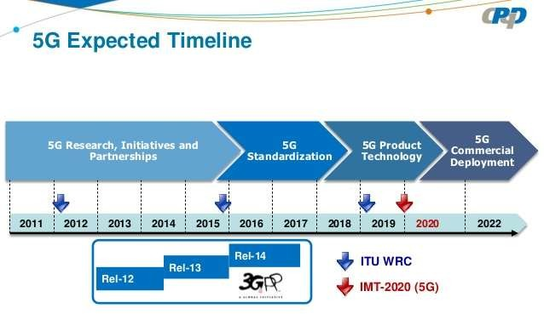
Standardization Process
Standardization takes as much as 10 years
» Setting goals, identifying technologies
» Standardization: many releases
» Product development and trials
13
Peter A. S
teenkiste

Slide 13
Overview
Cellular principles – “classic” view
» A bit of history
» Cellular design
» How does a mobile phone call take place?
» Handoff
» Frequency Allocation, Traffic Engineering
Early cellular generations: 1G, 2G, 3G
Today’s cellular: 4G – LTE
Emerging: 5G widely advertised
Some slides based on material from
“Wireless Communication Networks and Systems”
© 2016 Pearson Higher Education, Inc.
Peter A. Steenkiste
14

Slide 14
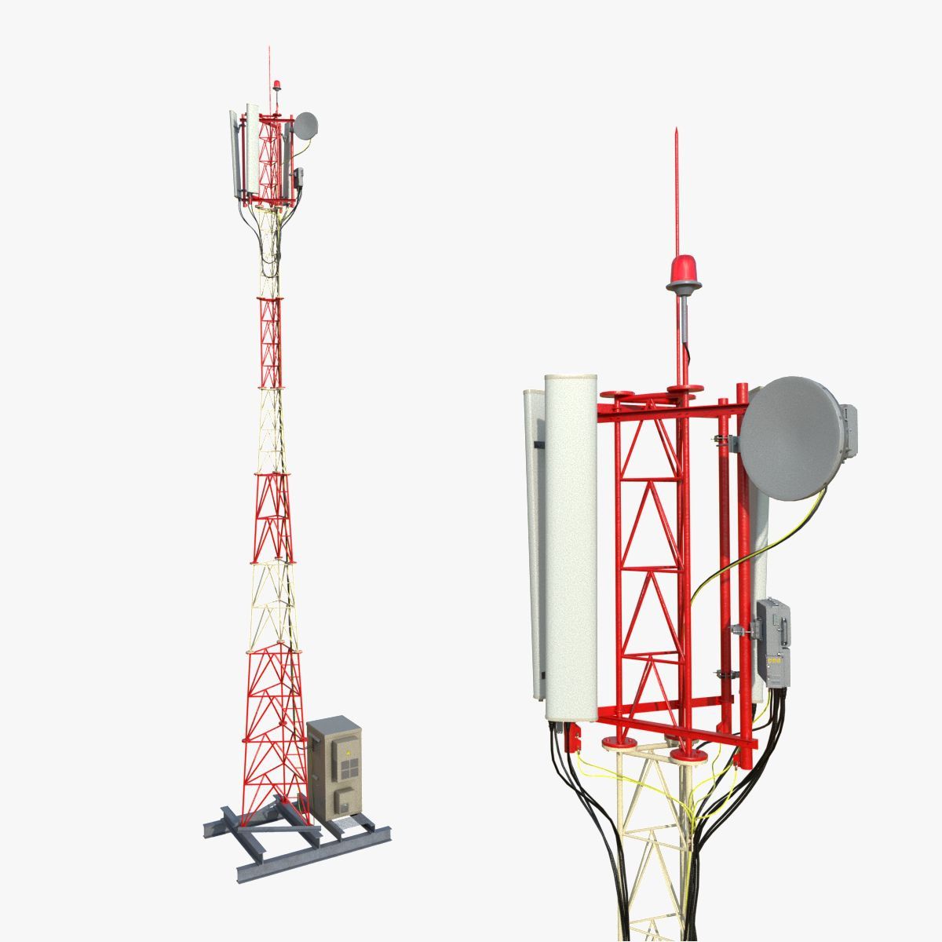
Cellular Network Definitions
Base Station:
In telecommunications, a base station is a fixed transceiver that is the main communication point for one or more wireless mobile client devices.
A base station serves as a central connection point for a wireless device to communicate. It further connects the device to other networks or devices, usually through dedicated high bandwidth wire or fiber optic connections.

Slide 15
Cellular Network Definitions (cont.)
Forward channel: The Forward channel is the direction of the communication or base station to-mobile downlink path
Reverse channel: The Reverse channel is used by the individual users in their actual calls to transmit traffic from a single mobile to base station
Control channel: Radio channel used for call request, call setup, call initiation and other control purposes

Slide 16
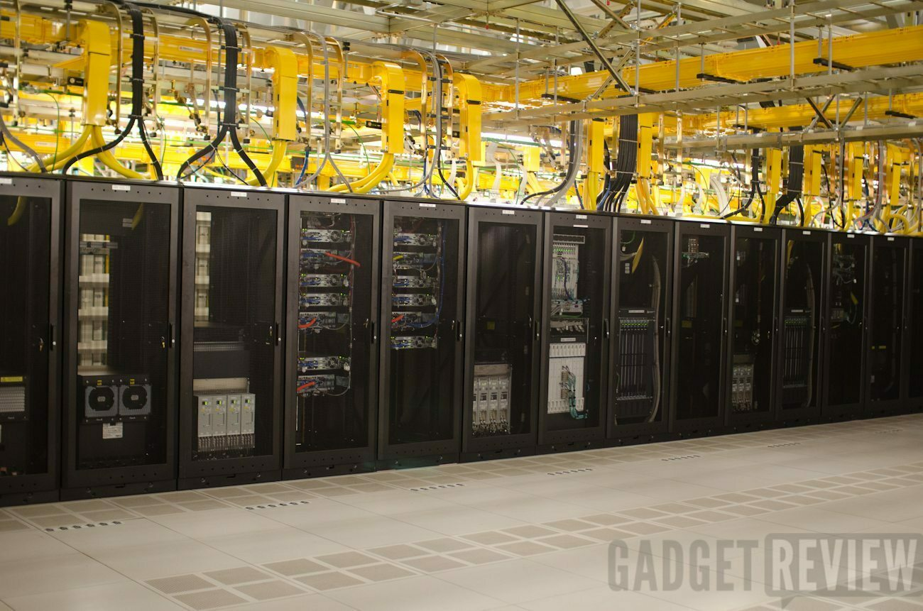
Cellular Network Definitions (cont.)
Mobile Switching center (MSC): it is the centerpiece of a network switching subsystem (NSS). The MSC is mostly associated with communications switching functions, such as call set-up, release, and routing.
it also performs a host of other duties, including routing SMS messages, conference calls, fax, and service billing as well as interfacing with other networks, such as the public switched telephone network (PSTN).

Slide 17
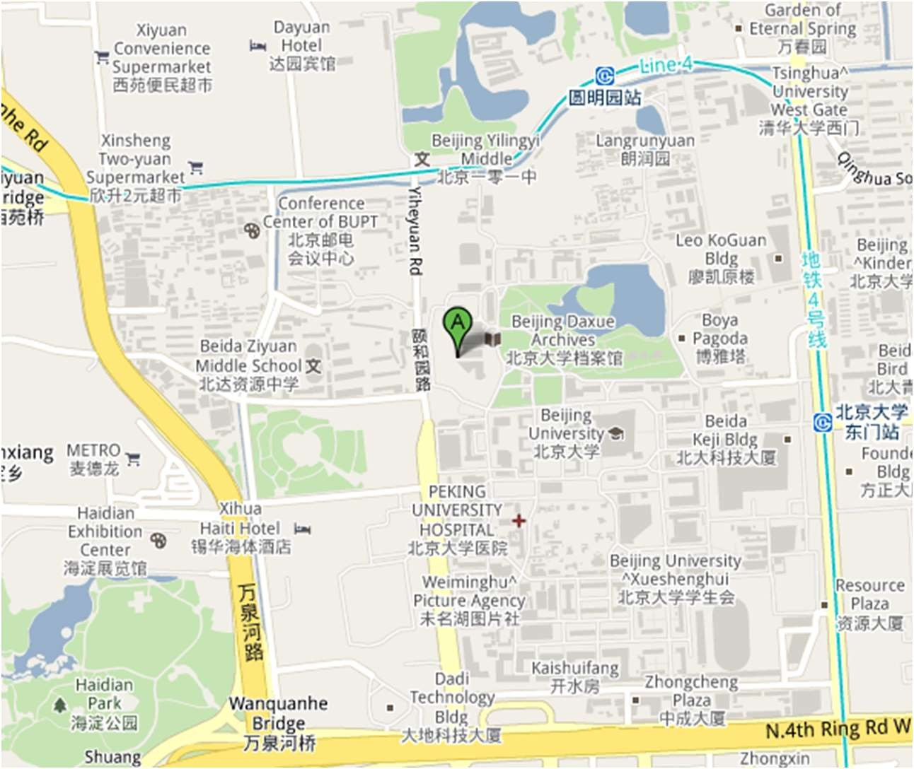
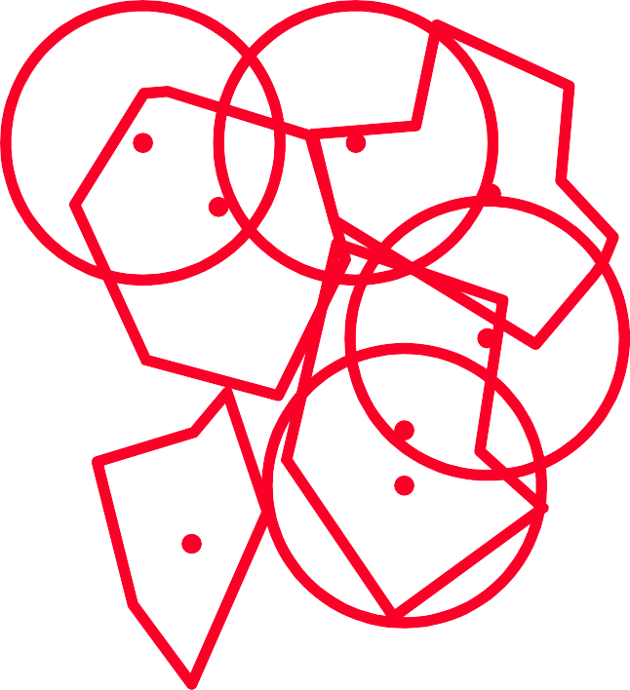
How To Design
a Cellular Network?
Need to get good coverage everywhere
Must be able to plan network based on demand

Slide 18
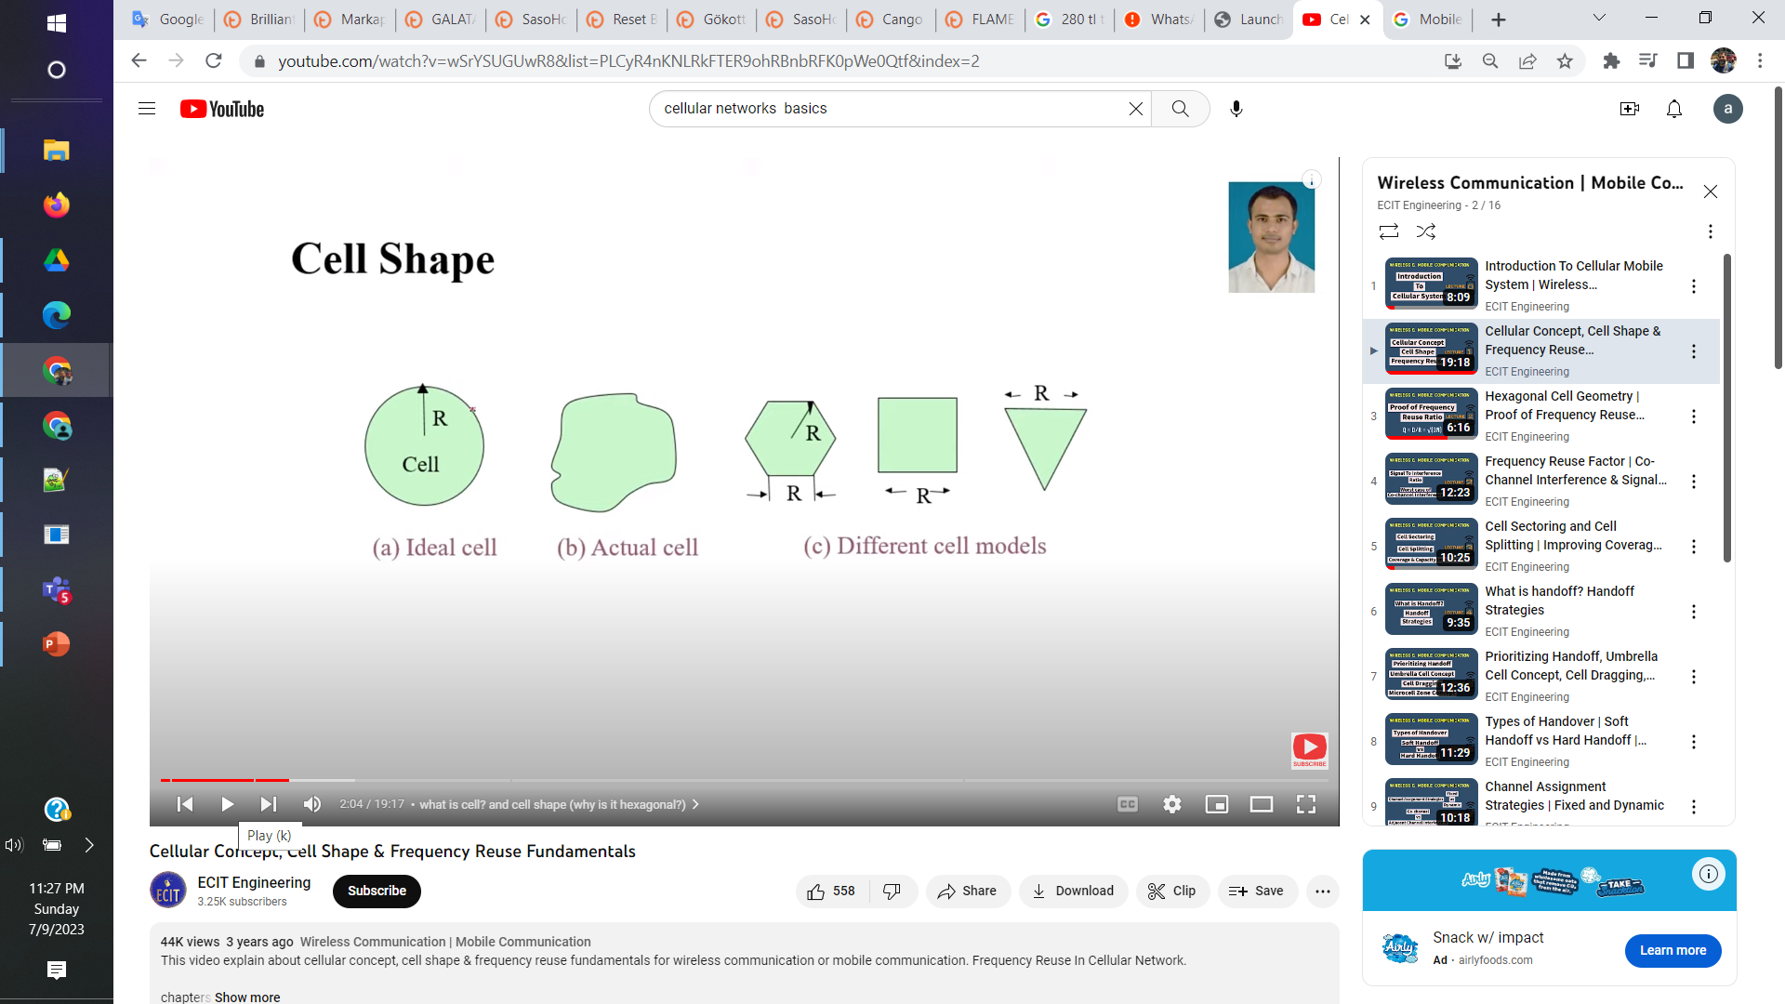
Cell shape

Slide 19
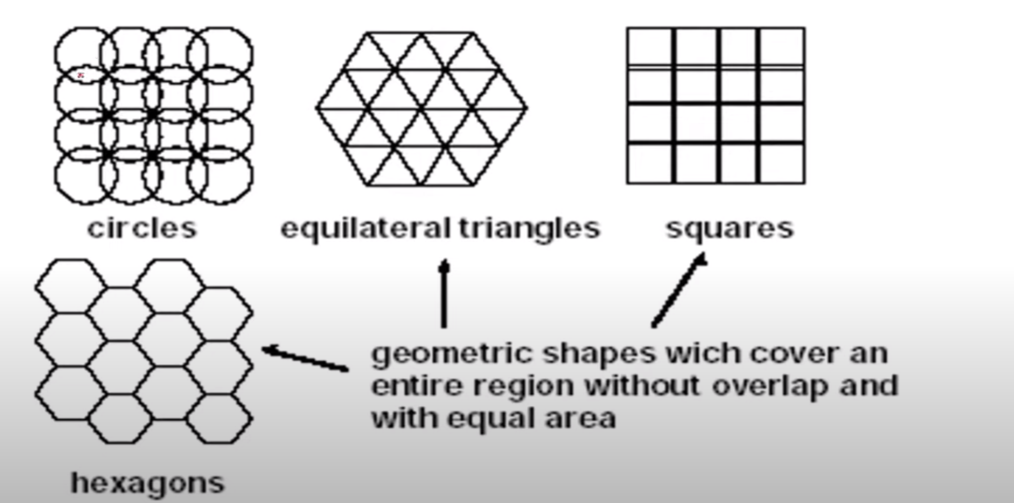
Cellular Network Design Options

Slide 20
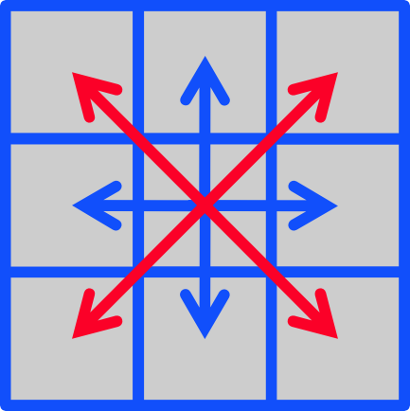
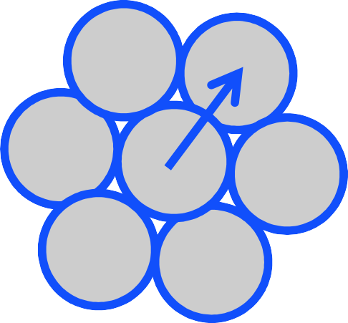
Cellular Network Design Options
Simplest layout
» Does not match any propagation model
» Adjacent antennas not equidistant – how do you handle users at the edge of the cell?
d
√2d
d
d
“Ideal” layout
» Based on a naïve propagation model – bad approximation but better than squares
» Does not cover entire area!
d

Slide 21
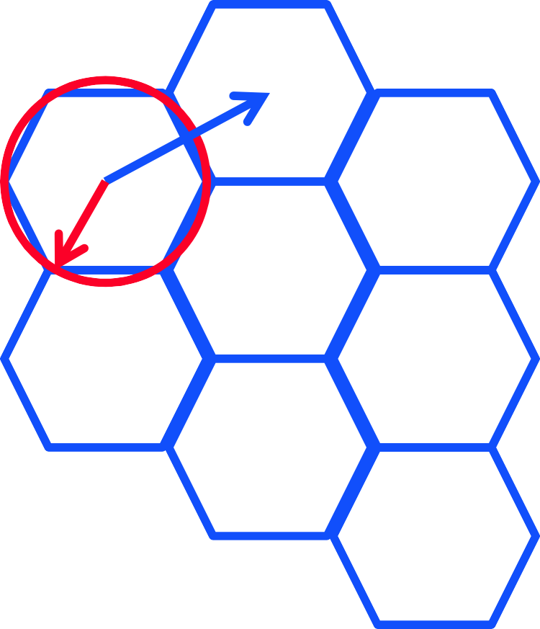
The Hexagonal Pattern
A hexagon pattern can provide equidistant access to neighboring cell towers
d = √3R
In practice, variations from ideal due to topological reasons
» Signal propagation
» Tower placement
d
R

Slide 22
Frequency reuse
Each cell features one base transceiver
Through power control the tower covers the cell area while limiting the power leaking to other co-frequency cells
The number of frequency bands assigned to a cell dependent on its traffic
» 10 to 50 frequencies assigned to each cell (early systems)
How do we determine how many cells must separate two cells using the same frequency?
» Need to control the “power to interference” ratio

Slide 23
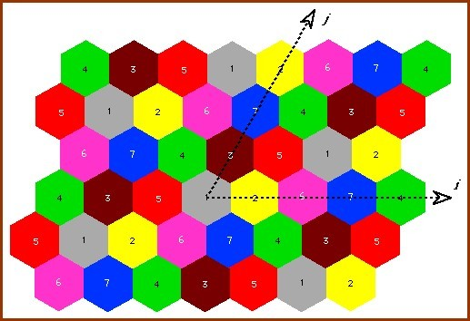
Minimum separation?

Slide 24
Frequency reuse characterization
D = minimum distance between centers of co- channel cells
R = radius of cell
N = number of cells in a repetitious pattern, i.e. reuse factor
Hexagonal pattern only possible for certain N:
N = I² + J² +(I*J) I,J =0, 1 , 2, 3, ...

Slide 25
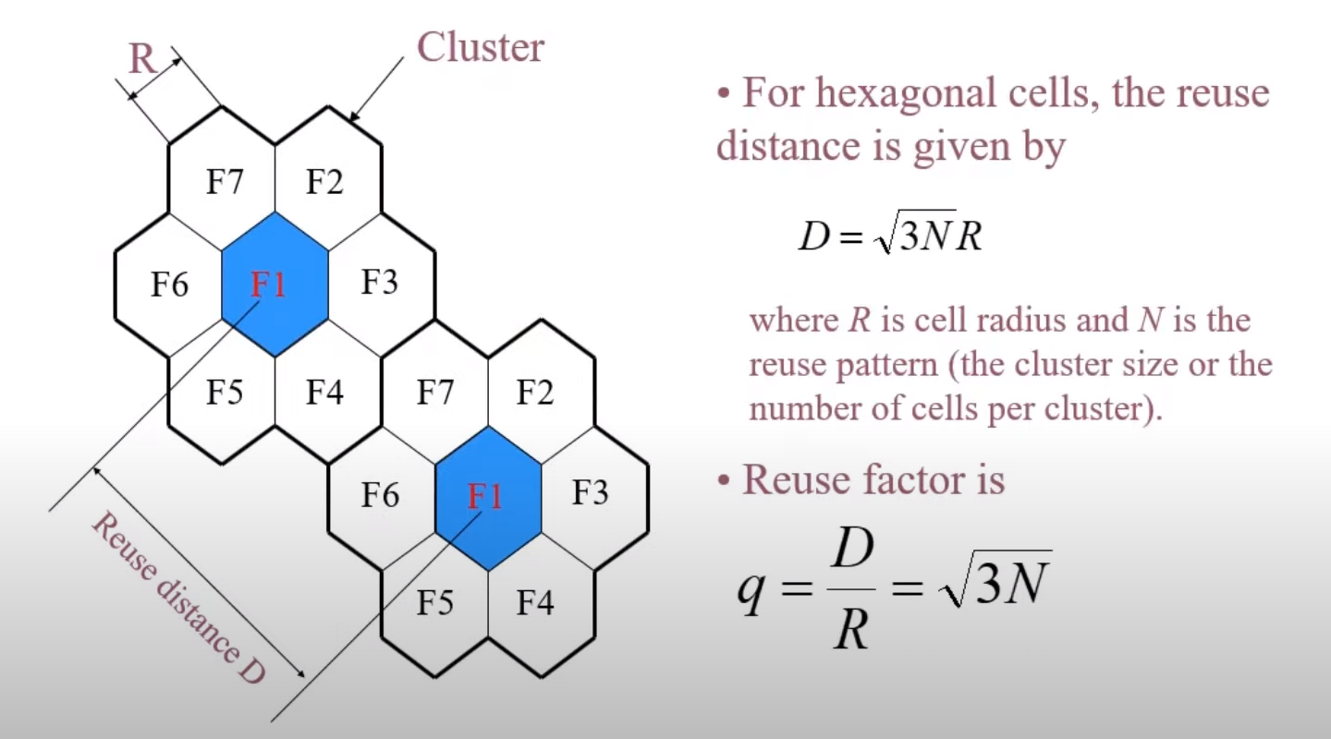
Frequency reuse characterization

Slide 26
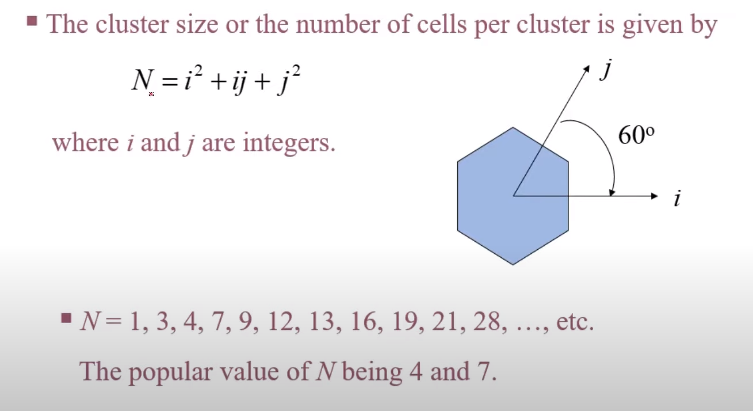
Reuse Distance

Slide 27
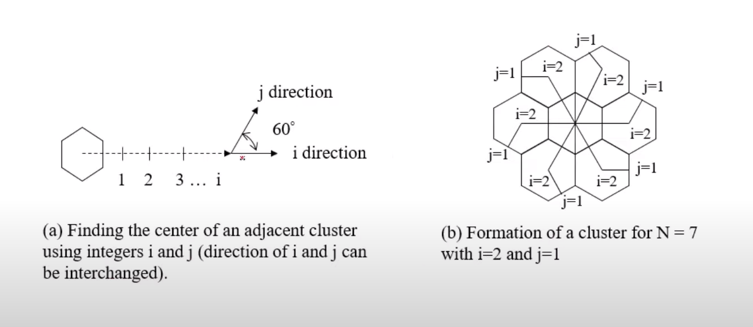
Reuse Distance (cont..)

Slide 28
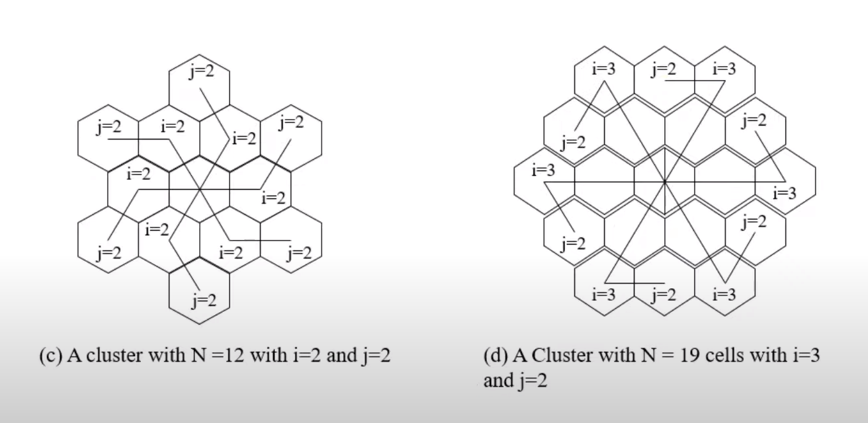
Reuse Distance (cont..)

Slide 29
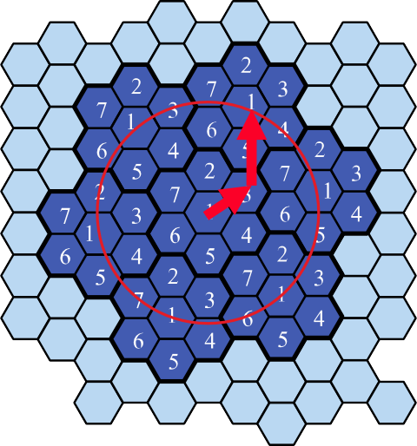
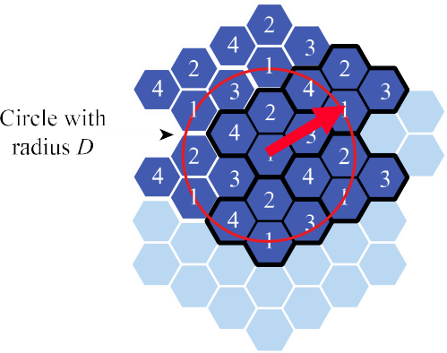
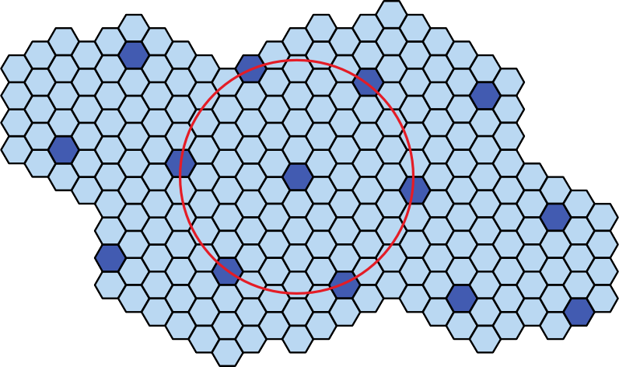
Frequency Reuse Pattern Examples

Slide 30
Capacity and Interference
S = Total # of duplex channels available for use
k = Total # of duplex channels per cell (k<S)
N = Size of cluster, i.e., cells that collectively use the complete set of available frequencies
^{S} = N or S = kN
k
If a cluster is replicated M times within the system, the total # of duplex channels C can be used as a measure of capacity
C = MkN = MS

Slide 31
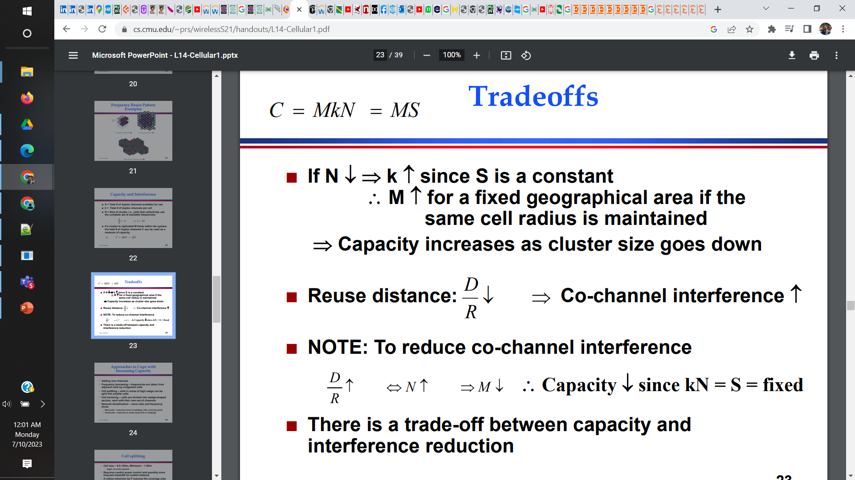

Slide 32
Reuse distance and Co-channel interference

Slide 33
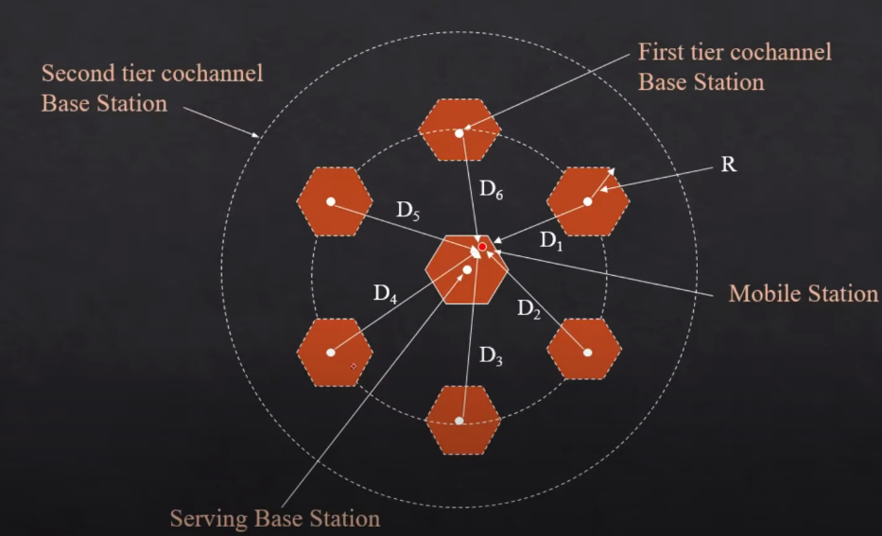
Co-channel interference
Notes:
We are interested in finding signal to interference ratio

Slide 34
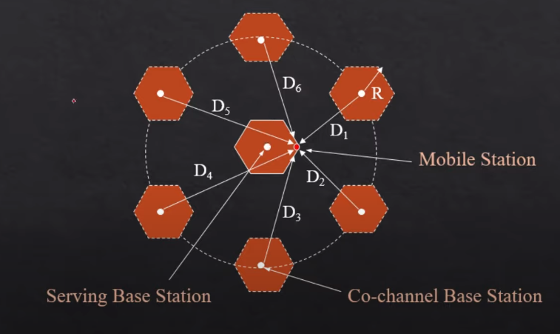
Worst case co-channel interference

Slide 35
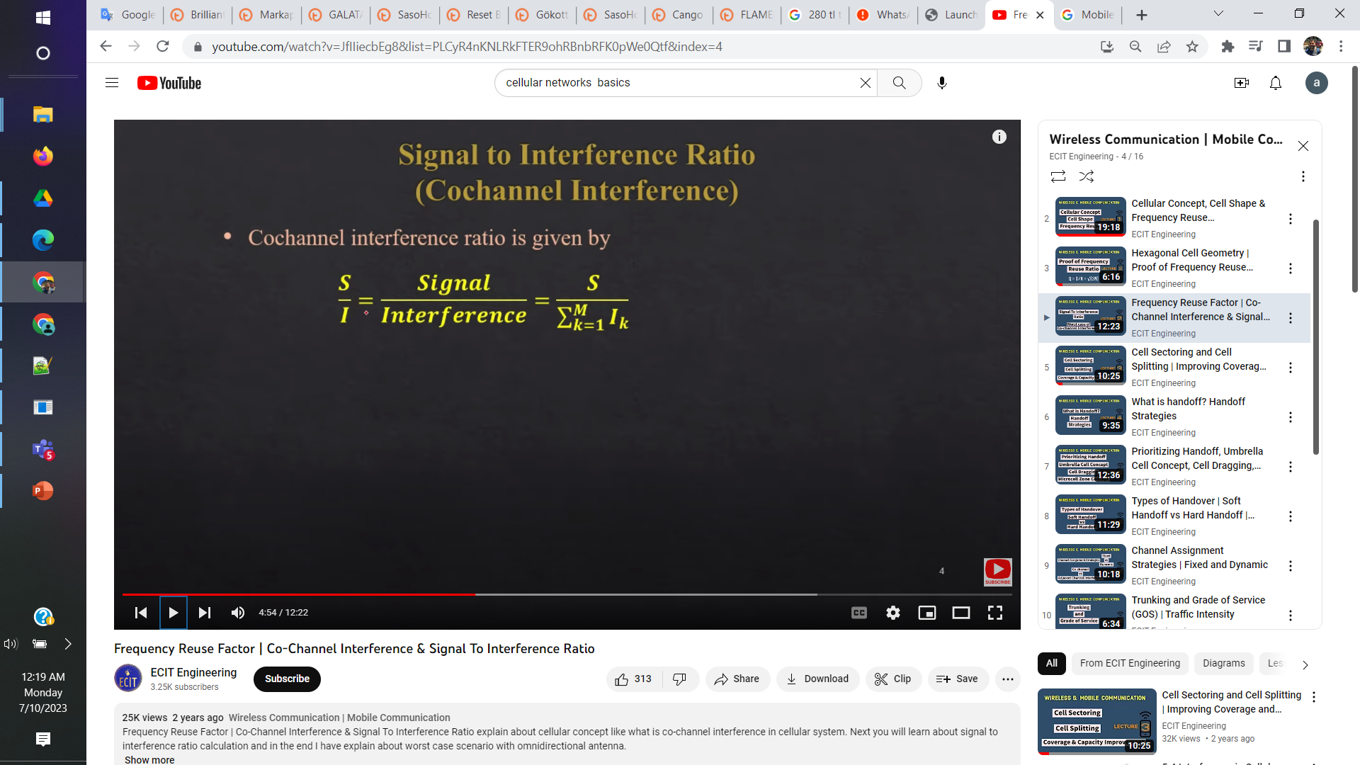
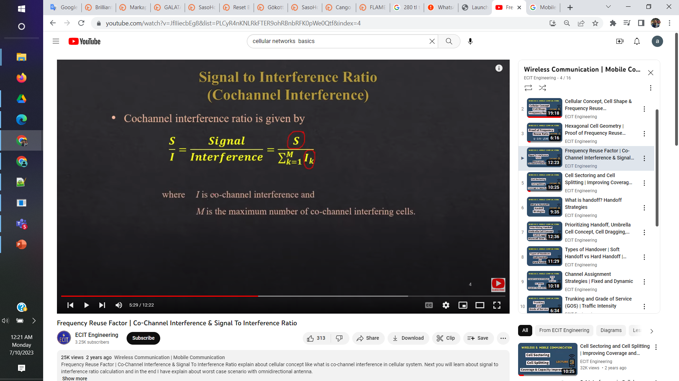
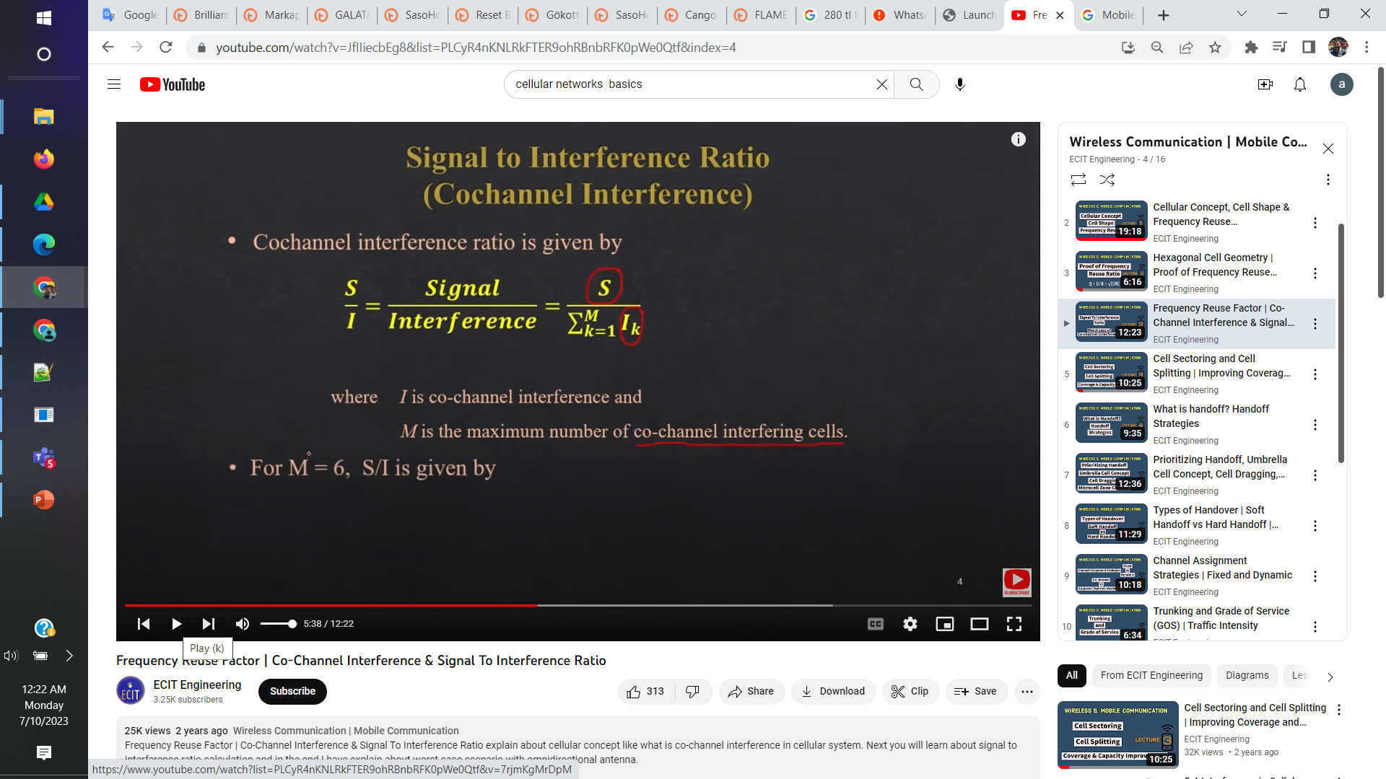
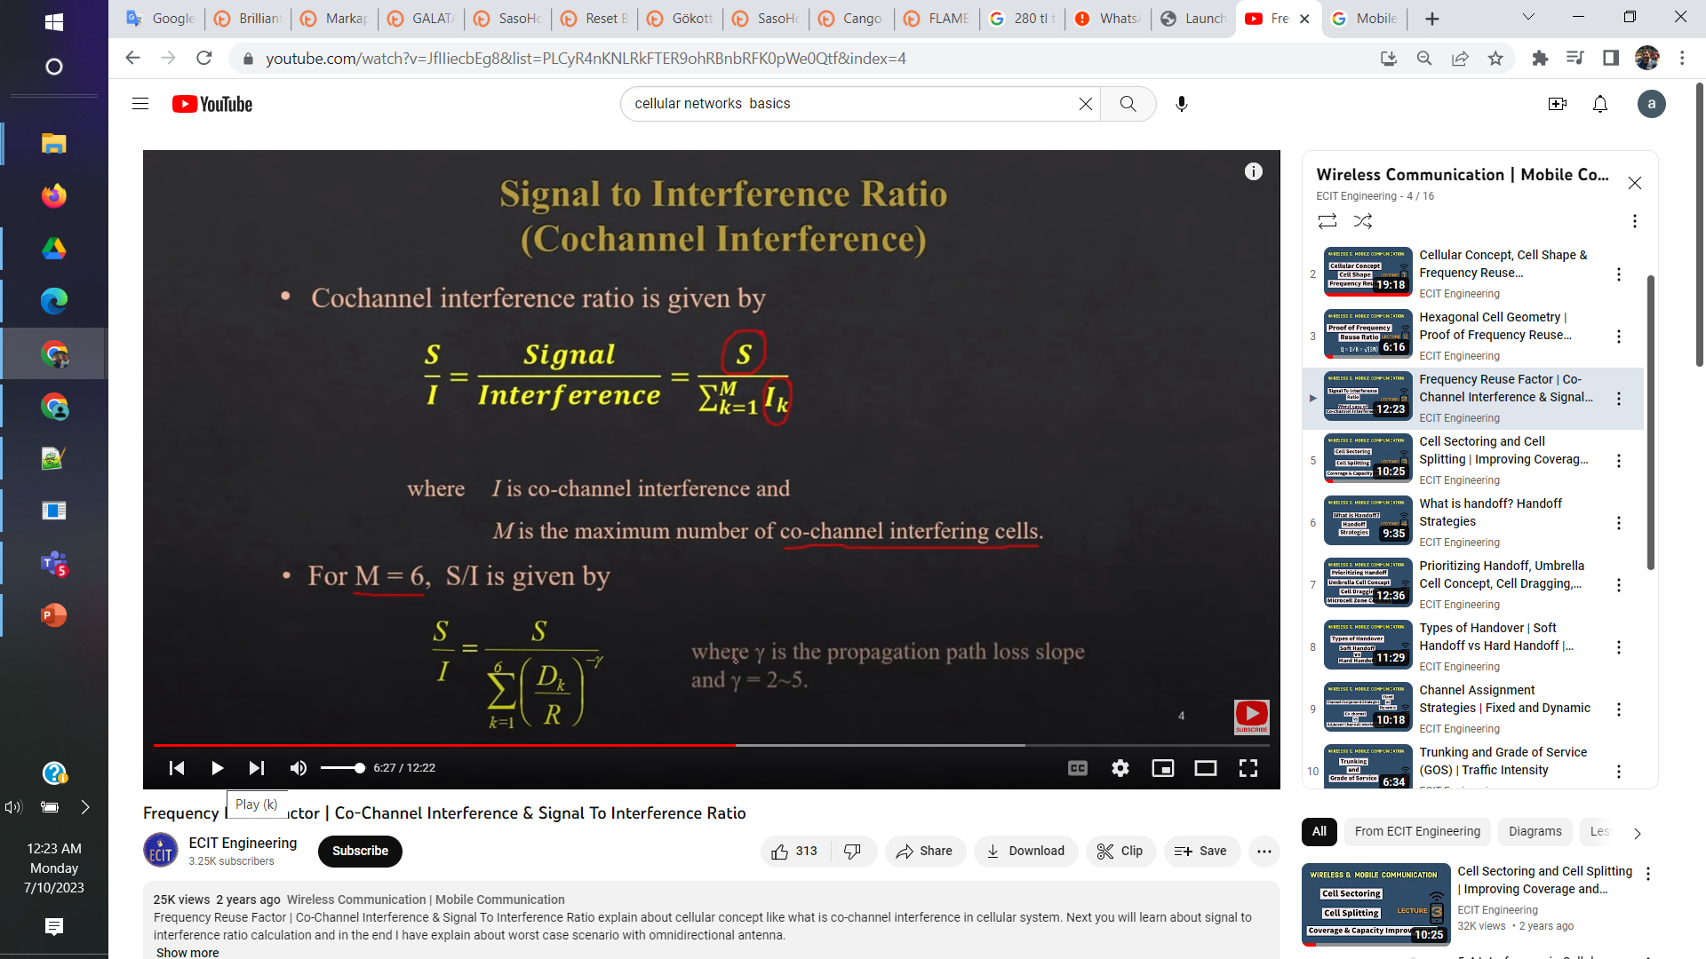
Signal to interference ratio

Slide 36
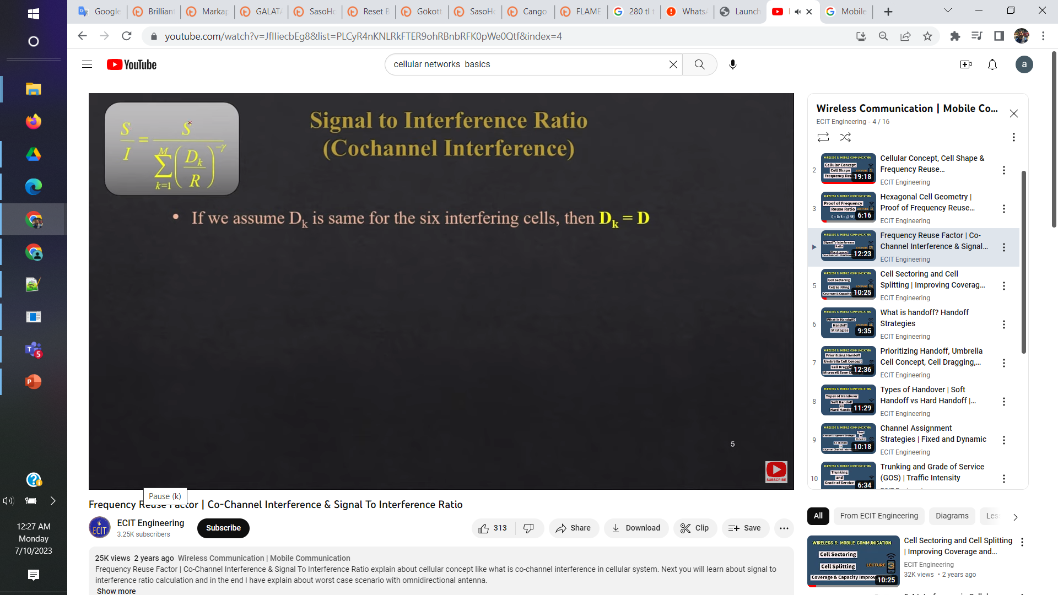
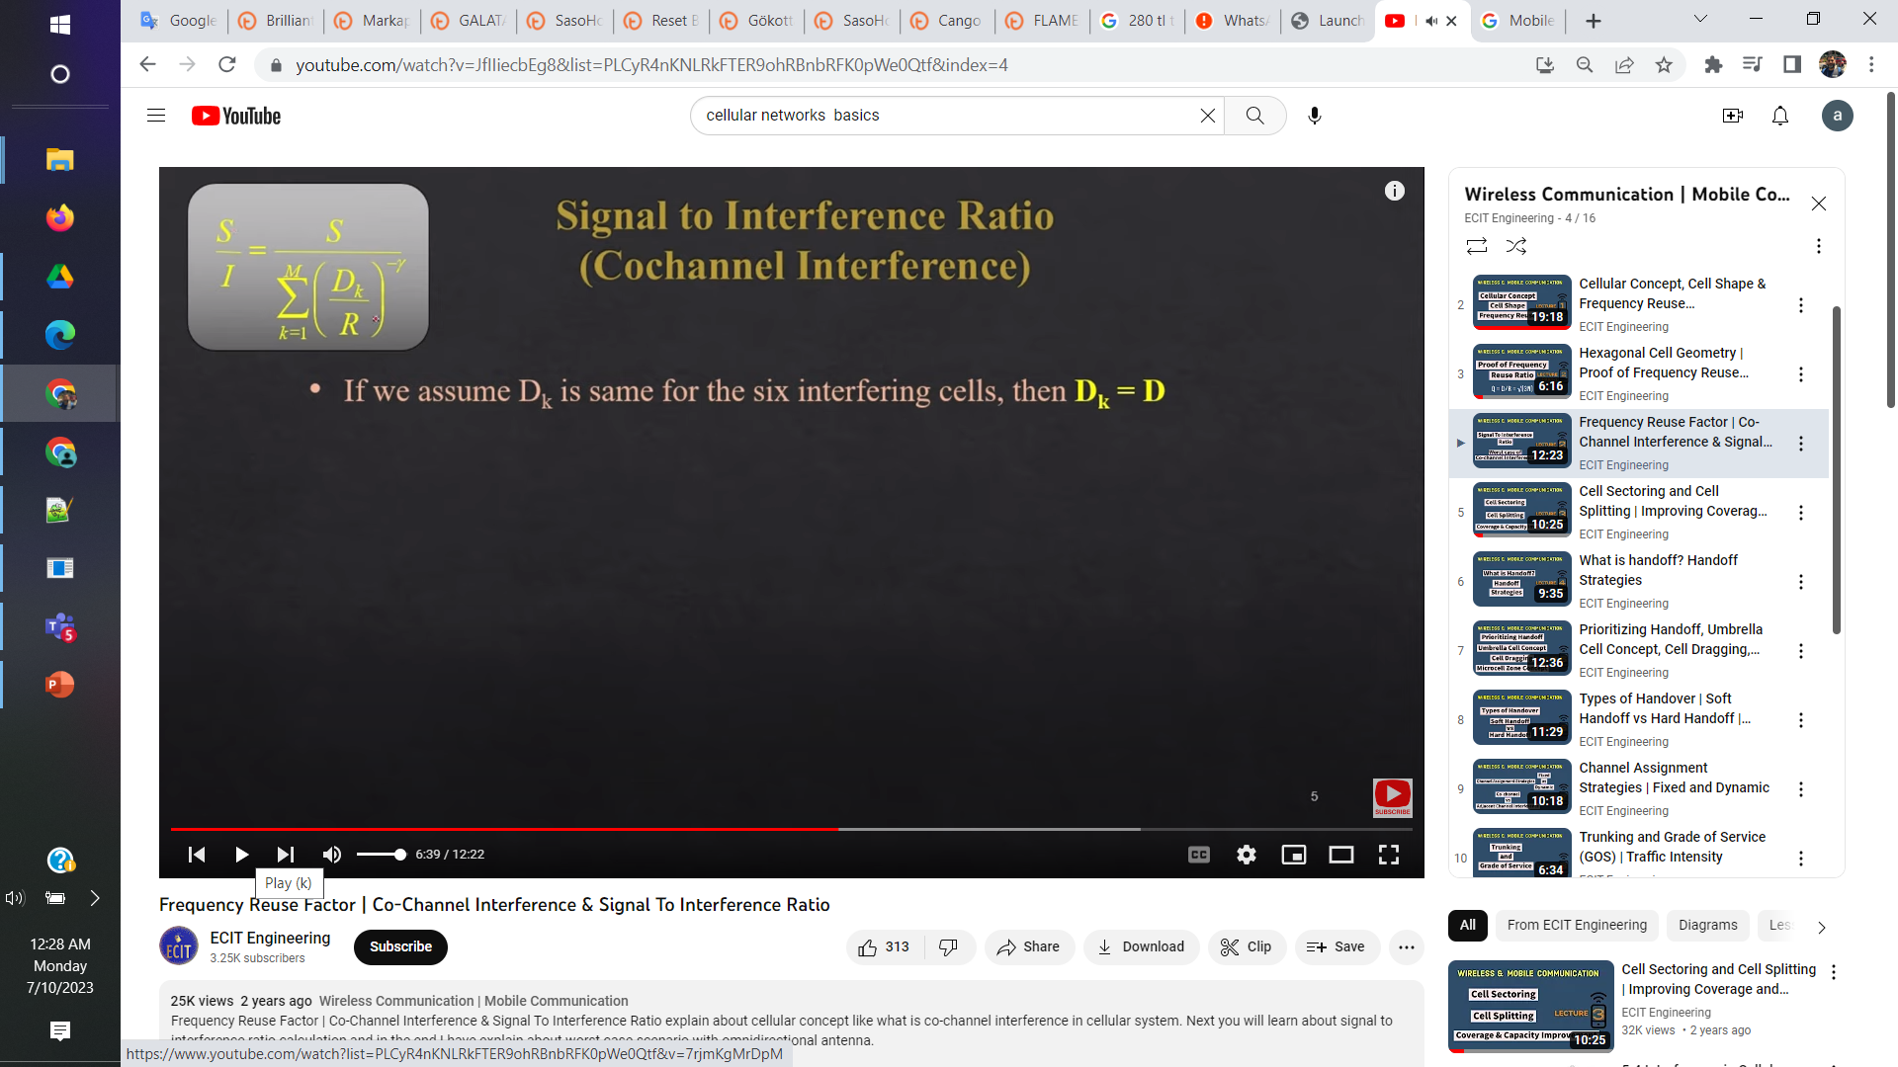
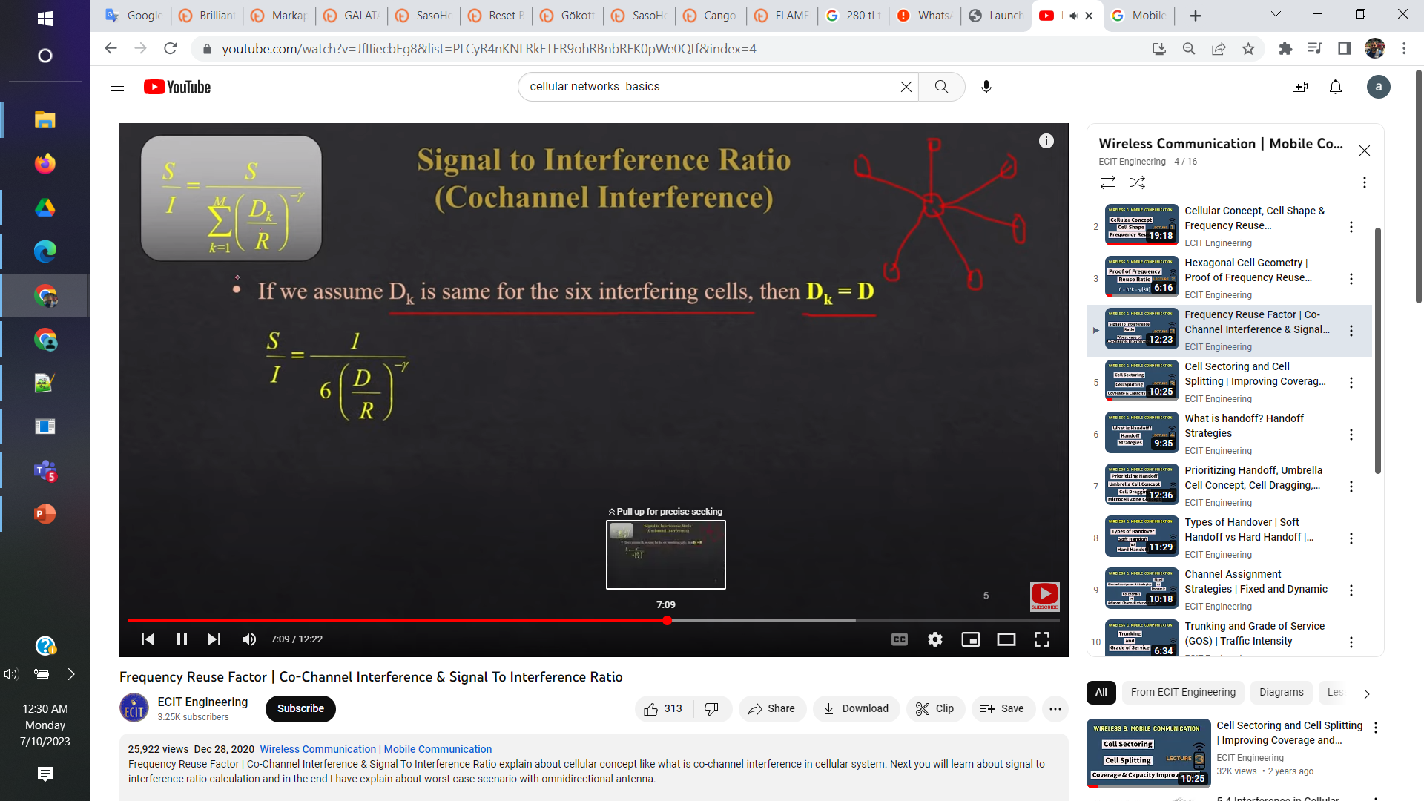
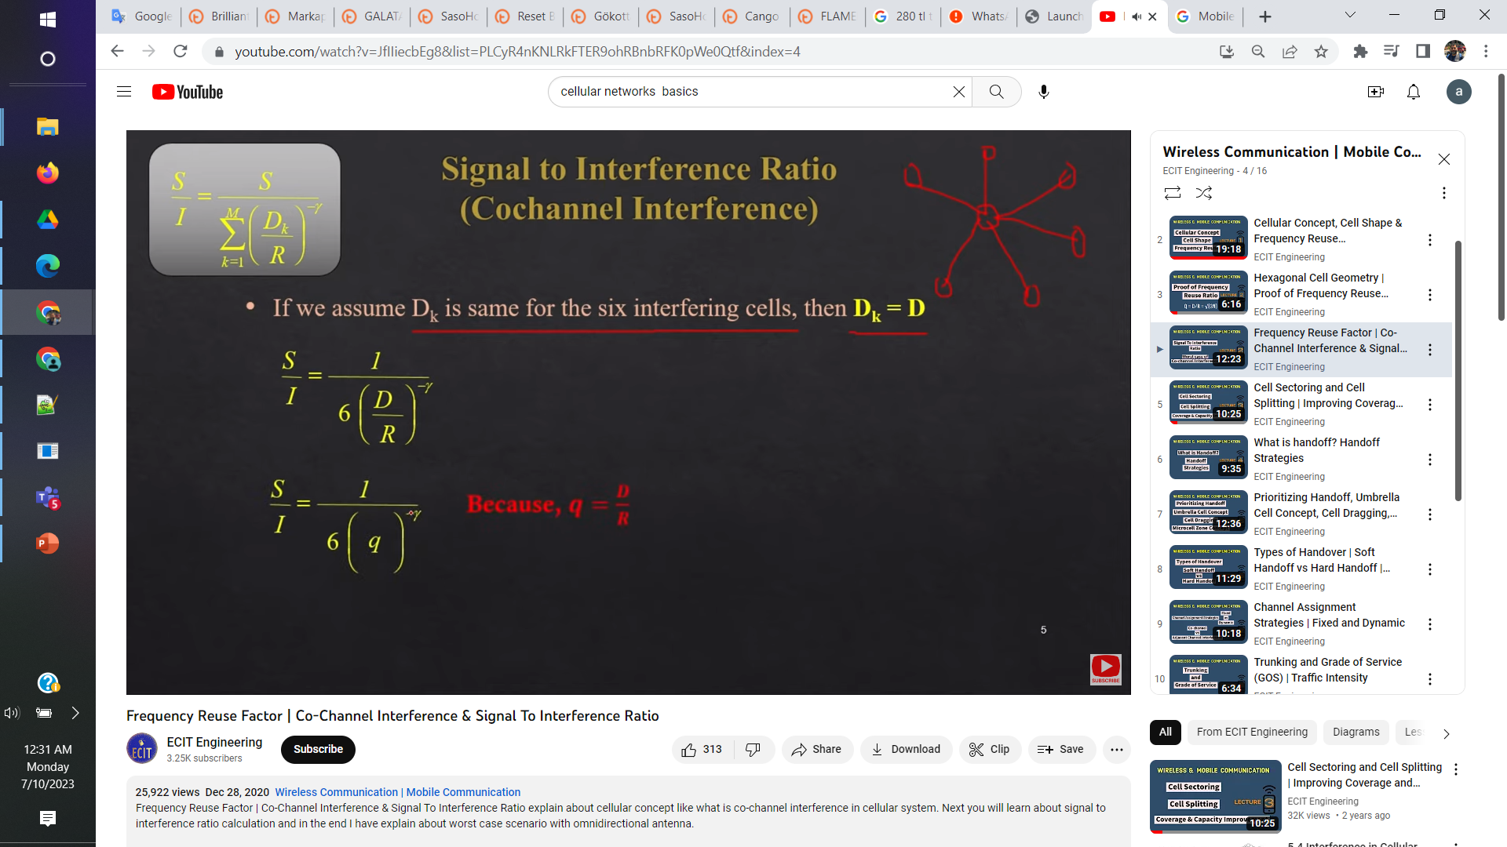

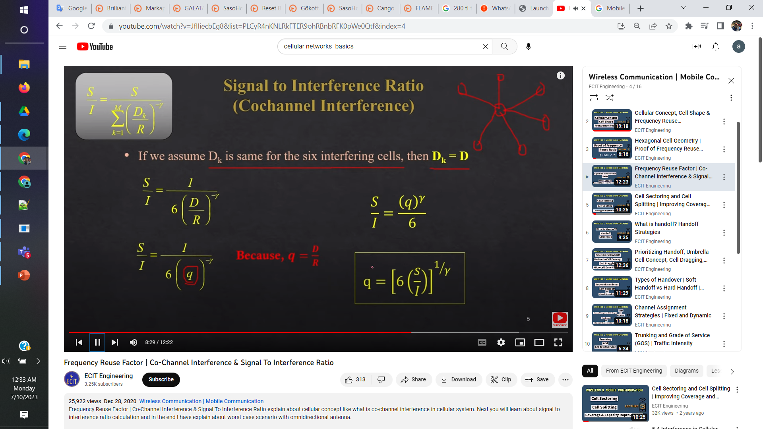
Signal to interference ratio

Slide 37
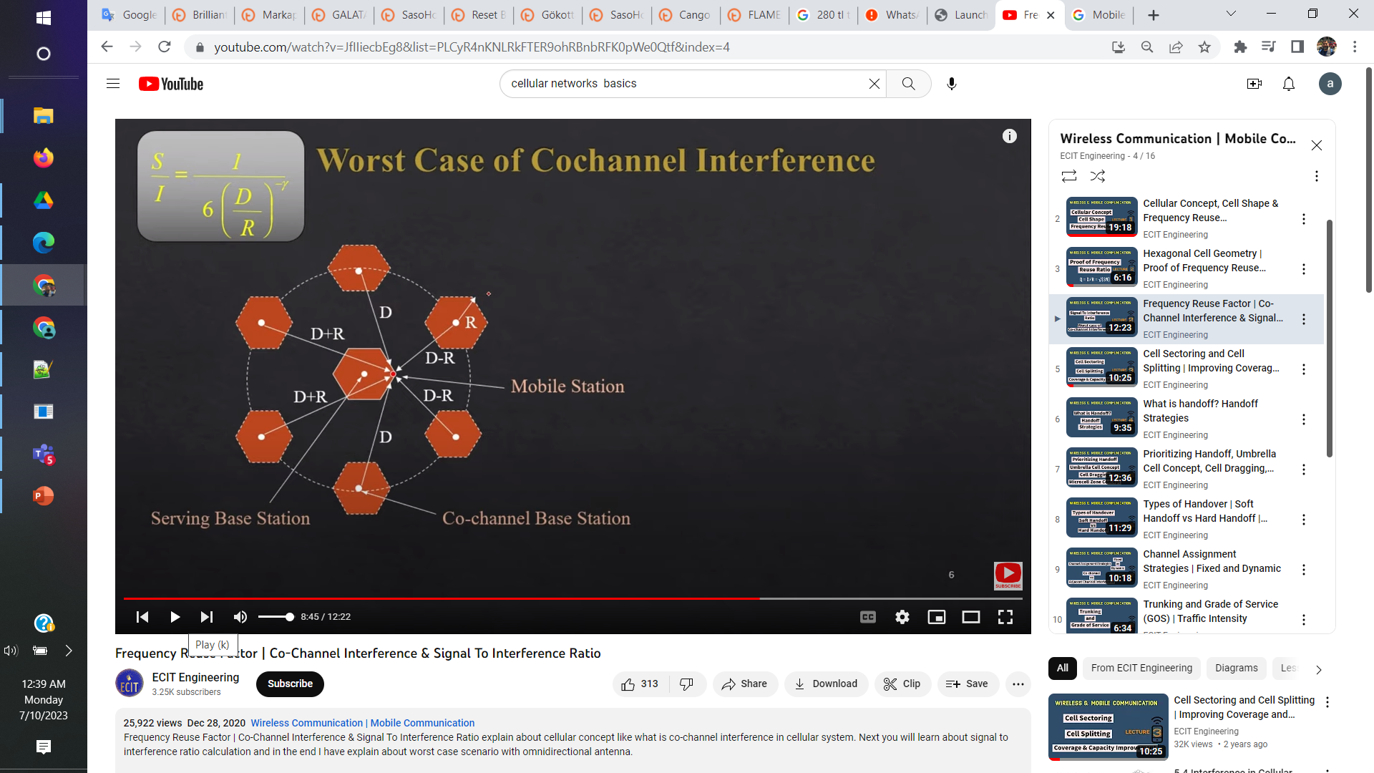
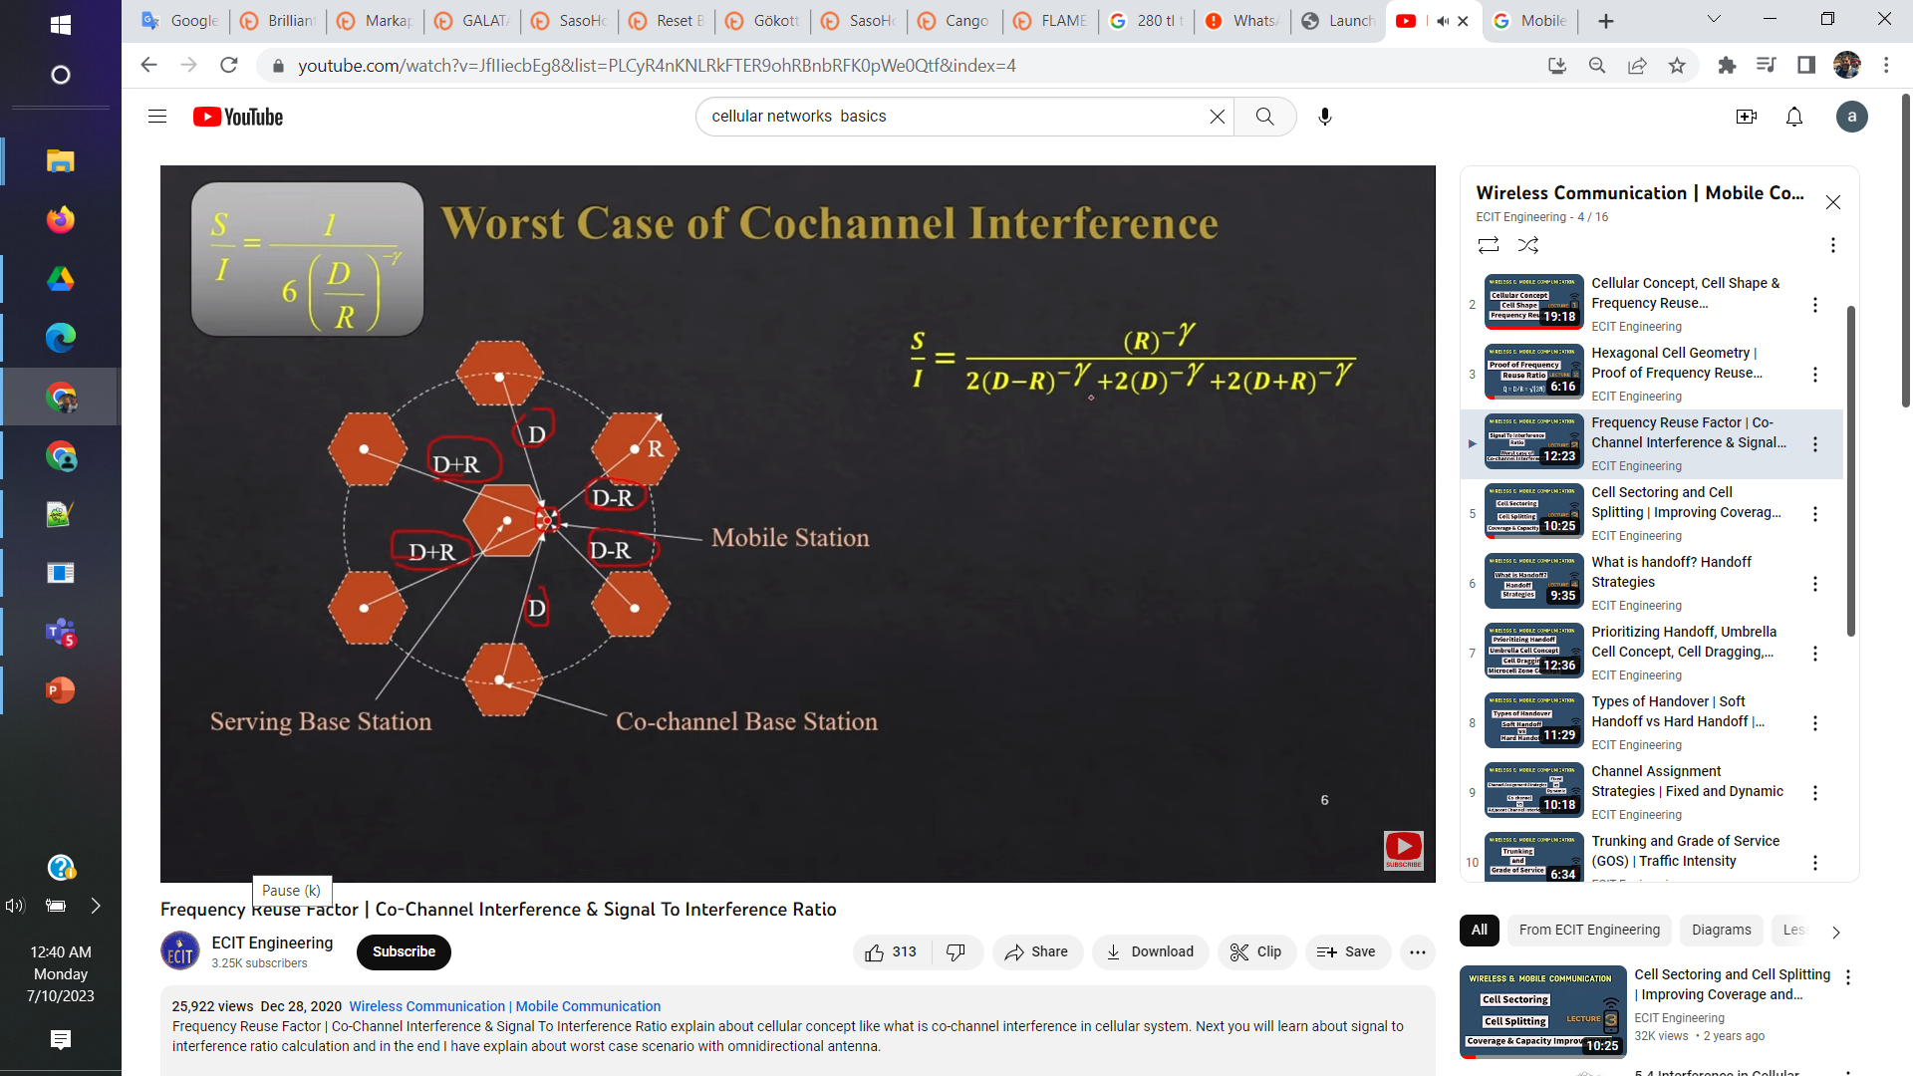
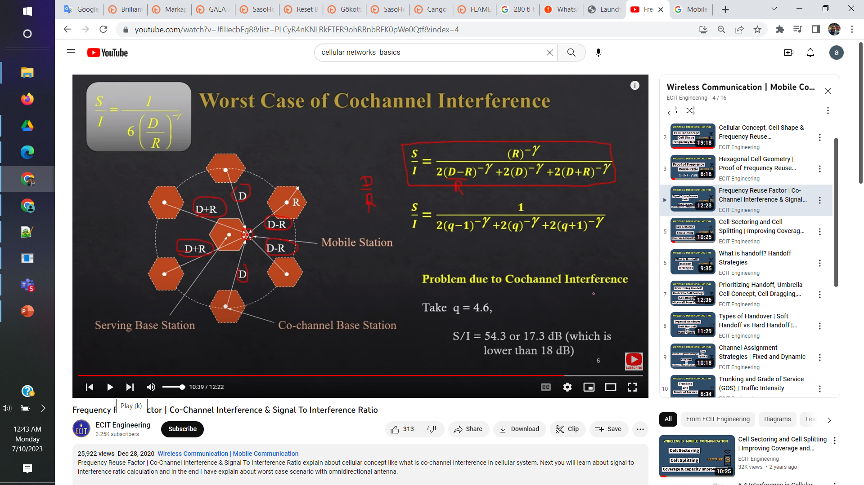
Worst case Co-channel interference

Slide 38
Approaches to Cope with Increasing Capacity
Adding new channels
Frequency borrowing – frequencies are taken from adjacent cells by congested cells
Cell splitting – cells in areas of high usage can be split into smaller cells
Cell sectoring – cells are divided into wedge-shaped sectors, each with their own set of channels
Network densification – more cells and frequency reuse
» Microcells – antennas move to buildings, hills, and lamp posts
» Femtocells – antennas to create small cells in buildings

Slide 39
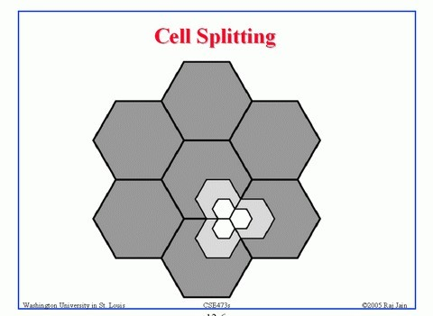
Cell splitting
Cell size ~ 6.5-13Km, Minimum ~ 1.5Km
» Again, for early systems
Requires careful power control and possibly more frequent handoffs for mobile stations
A radius reduction by F reduces the coverage area and increases the number of base stations by _{F} ²

Slide 40
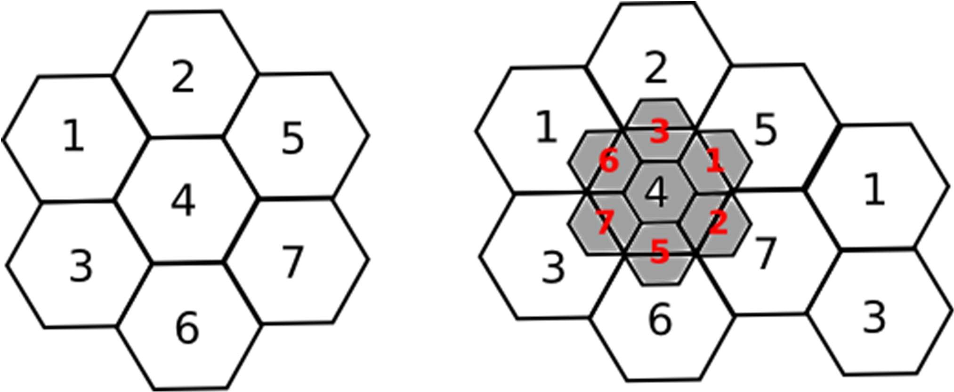
Cell splitting
Radius of small cell half that of the original

Slide 41
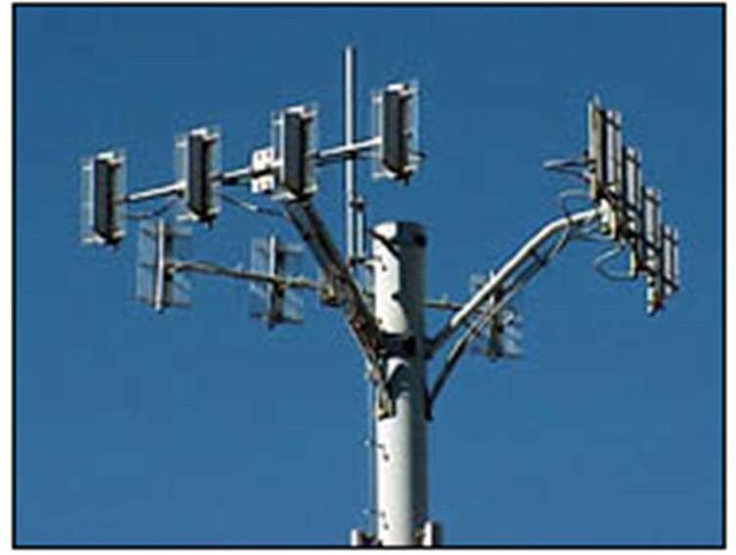
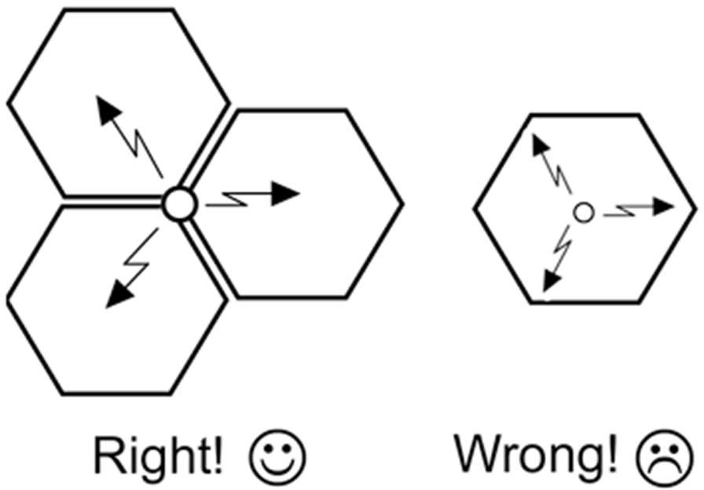
Cell sectoring
Cell divided into wedge shaped sectors
3-6 sectors per cell, each with own channel set
Subset of cell’s channel, use of directional antennas

Slide 42
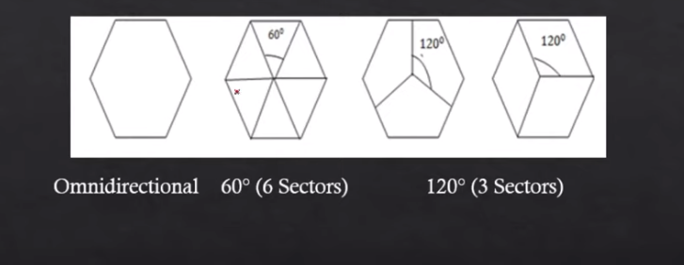
Cell Sectoring
Subset of cell’s channel, use of directional antennas

Slide 43
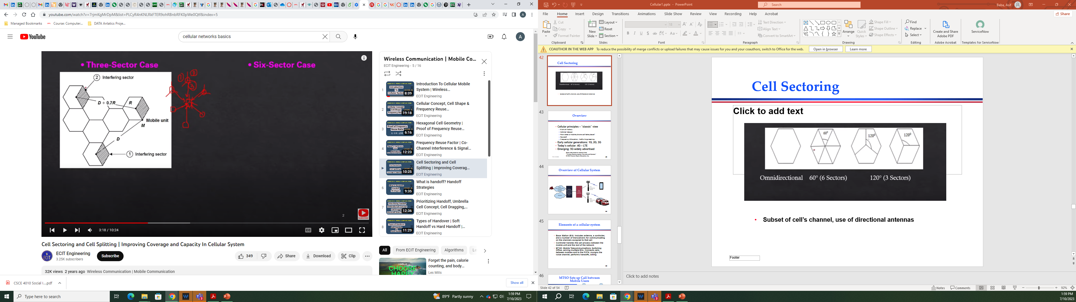
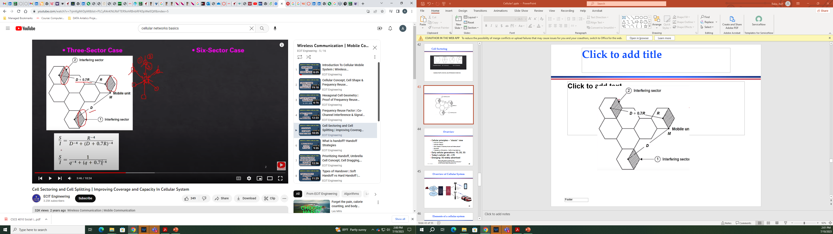
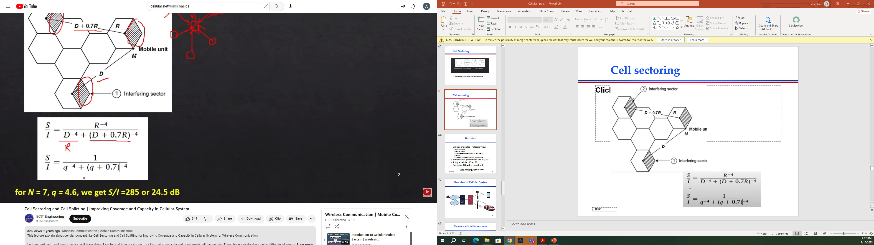
Cell sectoring (3 sectoring)

Slide 44
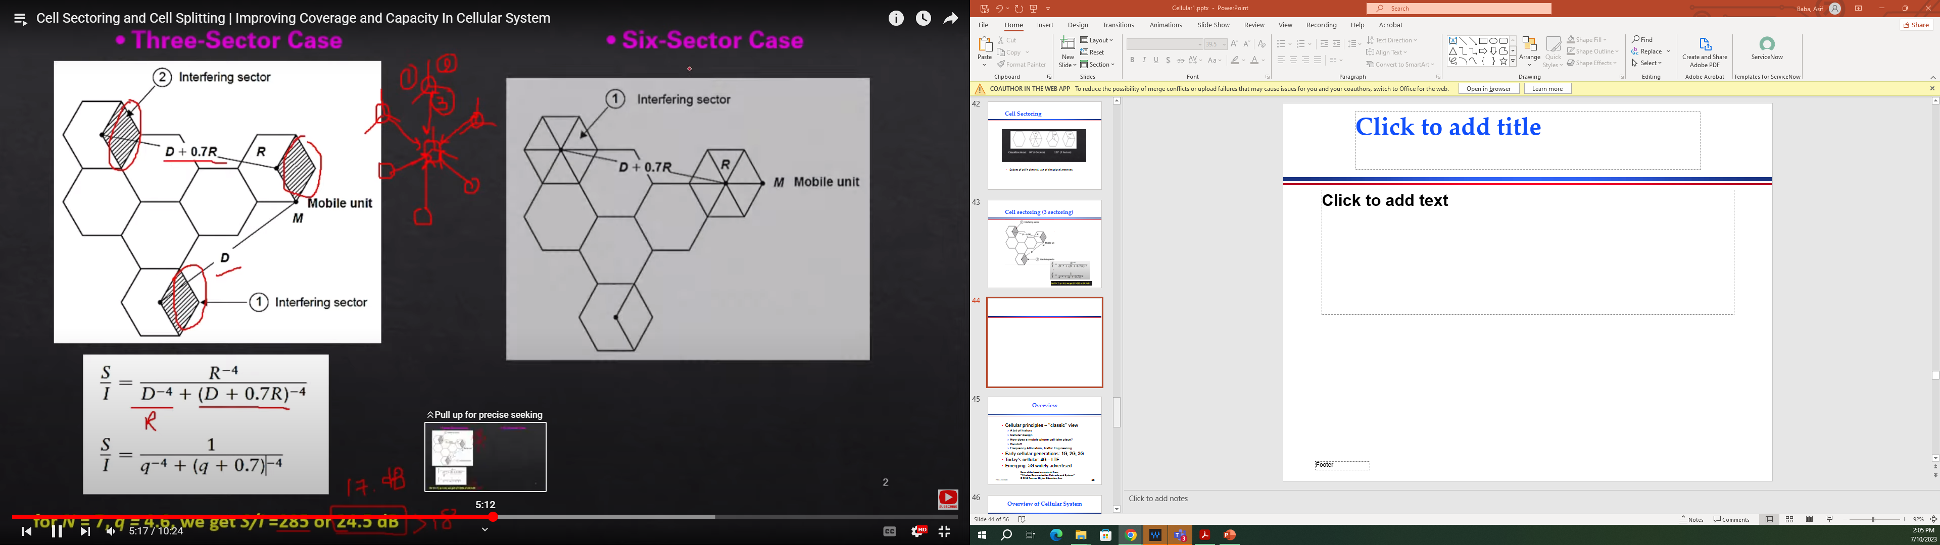
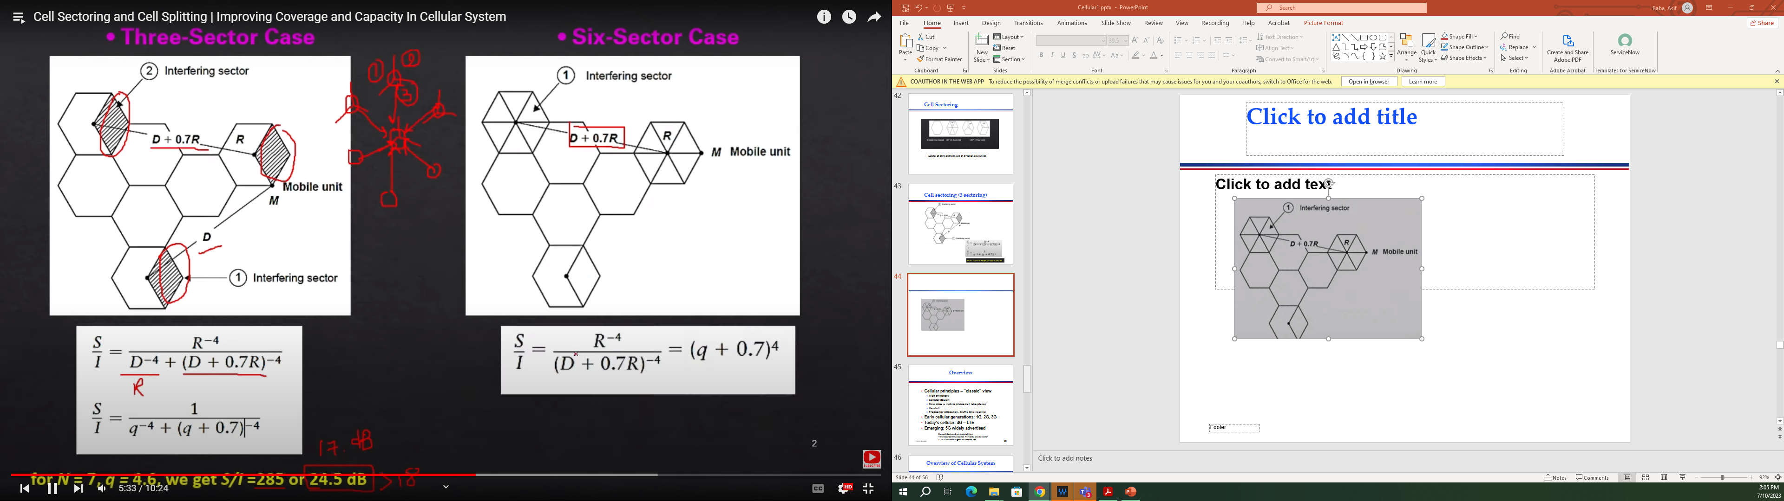
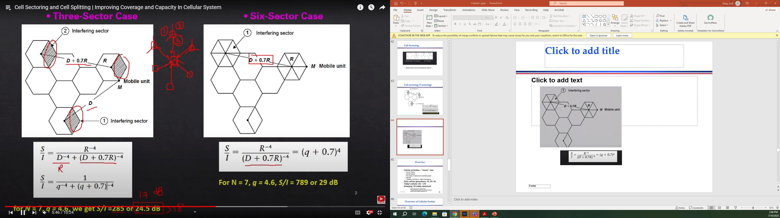
Cell sectoring (6 sectoring)

Slide 45
Overview
Cellular principles – “classic” view
» A bit of history
» Cellular design
» How does a mobile phone call take place?
» Handoff
» Frequency Allocation, Traffic Engineering
Early cellular generations: 1G, 2G, 3G
Today’s cellular: 4G – LTE
Emerging: 5G widely advertised
Some slides based on material from
“Wireless Communication Networks and Systems”
© 2016 Pearson Higher Education, Inc.
Peter A. Steenkiste
28

Slide 46

Handoff

Slide 47

Handoff

Slide 48

Handoff

Slide 49
Handoff Strategies Used to Determine Instant of Handoff
Metrics related to handoff:
» Call blocking probability: probability of a new call being blocked
» Call dropping probability: probability that a call is terminated due to a handoff
Possible strategies for scheduling handoffs:
» Relative signal strength – L₁
» Relative signal strength with threshold Th₂ – L₂
» Relative signal strength with hysteresis H – L₃
» Relative signal strength with hysteresis and threshold Th₁ or Th₂ – L₃; Th₃ – L₄
» Prediction techniques
49

Slide 50











Example of Handoff
50

Slide 51
Handoff margin
△ = P_{handoff threshold} - P_{minimumusable signal}dB
carefully selected
• △ too large → unnecessary handoff → MSC loaded down
• △ too small → not enough time to transfer → call dropped!
• A dropped handoff can be caused by two factors
not enough time to perform handoff
delay by MSC in assigning handoff
high traffic conditions and high computational load on MSC can cause excessive delay by the MSC
no channels available in new cell

Slide 52
Handoff
Prioritizing Handoff
Umbrella Cell approach
Cell dragging
A Microcell Zone Concept

Slide 53
Prioritizing Handoff
Guard Channel: a fraction of the total available channels in a cell is reserved exclusively for handoff requests from ongoing calls which may be handed off into the cell.
This method has the disadvantage of reducing the total carried traffic, as fewer channels are allocated to originating calls.
However, a dynamic allocation of guard channel can address this issue.

Slide 54
Prioritizing Handoff
Queuing of Handoff Requests:
use time delay between handoff threshold and minimum useable signal level to place a blocked handoff request in queue
a handoff request can "keep trying" during that time period, instead of having a single block/no block decision
prioritize requests (based on mobile speed) and handoff as needed
calls will still be dropped if time period expires

Slide 55
Practical Handoff Considerations
Problems occur because of a large range of mobile velocities
pedestrian vs. vehicle user
Small cell sizes and/or micro-cells → larger # handoffs
MSC load is heavy when high speed users are passed between very small cells

Slide 56

Umbrella Cell

Slide 57
Umbrella Cell
use different antenna heights and Tx power levels to provide large and small cell coverage
multiple antennas & Tx can be co-located at single location if necessary (saves on obtaining new tower licenses)
large cell → high speed traffic → fewer handoffs
small cell → low speed traffic
example areas: interstate highway passing thru urban center, office park, or nearby shopping mall

Slide 58
Cell Dragging
low speed user w/ line of sight to base station (very strong signal)
strong signal changing slowly
user moves into the area of an adjacent cell without handoff
causes interference with adjacent cells and other cells
Remember: handoffs help all users, not just the one which is handed off.
If this mobile is closer to a reused channel → interference ­ for the other user using the same frequency
So this mobile needs to hand off anyway, so other users benefit because that mobile stays far away from them.

Slide 59
Mobile Radio Propagation Effects
Signal strength
» Must be strong enough to maintain signal quality at the receiver
» Must not be so strong as to create too much co-channel interference with channels in another cell using the same frequency band
» Fading may distort the signal and cause errors
Mobile transmission power minimized to avoid co-channel interference, alleviate health concerns and save battery power
In systems using CDMA, need to equalize power from all mobiles at the BS
59

Slide 60
Open and Closed Loop Power Control
Open loop power control: BS sends pilot
» Used by mobile to acquire timing and phase reference, and to assess channel attenuation
» Mobile adjust power accordingly
– Assume up and down channels are similar
» Can adjust quickly but not very accurate
Closed loop power control: power is adjust based on explicit feedback from receiver
» Reverse signal power level, received signal-to-noise ratio, or received bit error rate
» Mobile to BS: BS base station sends power adjustment command to mobile based on observed signal
» BS to mobile: BS adjust power based on information provided by mobile
60

Slide 61
Fixed Channel Assignment (FCA)
Each cell is allocated a predetermined set of voice channels.
Any call attempt within the cell can only be served by the unused channels in that cell
If all the channels in that cell are being used the call is blocked, which implies the user does not get service
A variation of FCA: the cell whose channels are all being used is allowed to borrow channels from the next cell. MTSO supervises this operation.
61

Slide 62
Dynamic Channel Assignment (DCA)
Channels are not permanently assigned to cells. Instead, for each request the BS requests a channel from the MTSO.
MTSO allocates a channel using an algorithm that takes many factors into account
» The likelihood of future blocking within the cell, the frequency of use of the candidate channel, the reuse distance of the channel, and other cost functions.
» MTSO only allocates a channel if it is not being used in the restricted distance for co-channel interference
DCA can use channels more effectively but incurs measurement, communication, and computer overhead
62

Slide 63

Channel Assignment

Slide 64

Channel Assignment

Slide 65
Traffic Engineering
If the cell has L subscribers..
… and can support N simultaneous users.
If L<=N, nonblocking system
If L>N, blocking system
Questions operator cares about:
» What is the probability of a call being blocked?
» What N do I need to upper bound this probability?
» If blocked calls are queued, what is the average delay?
» What capacity is needed to achieve a certain average delay?
Difficult problem but important
65

